Slide 1
Learning about Taxes with Intuit ProFile

Slide 2
Chapter 2 Installation and Setup

Slide 3
In this Chapter
Installing & activing ProFile
Managing Licenses
EFILE credentials
The Options menu

Slide 4
Installing ProFile
Single user installation
Multi-user installation
Activation
Licensing information
Managing Licenses
Adding & deleting
Notes:
Refer to Page 5 and discuss
Single-user installation
Also discuss Multi-user installation on Page 10
Then refer to Page 7
Activation (mention importance of Product Code & License Key
Discuss Adding and removing licenses on Page 8

Slide 5
Flexible licensing
What is it?
How does it work?
Maximum licenses
License overused
How to prevent?
Notes:
Refer to Page 11 and discuss
Flexible licensing
Multiple computers / Same license (non-concurrent only)
Also mention that computers must have online access in order to activate/suspend licenses
Then refer to Maximum license warnings Page 13
This happens when the same license is used too often (more times than allowable units)
Explain you can prevent this from happening by deleting licenses on old computers

Slide 6
Setting it up
setting it up
Notes:
Introduce this section by describing the inefficiency inherent in an incomplete setup (constantly resetting forms to print, file preferences such as file location etc.)
Describe the Options on page 14 and mention how these options help dig down into the guts of the software
Describe how you can set a host of parameters including file location, file preferences, customized templates and more.
Mention that some setup options are mandatory (EG, File Preparer & EFILE settings) and some are perhaps optional, but yet recommended
Let’s start with the more-or-less Mandatory Options

Slide 7
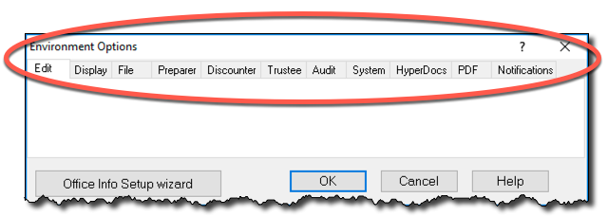
environment options
page 15
setting it up
Notes:
Notice the Options menu has a number of sub-menus (Environment, Module, Database, etc.)
EMPHASIZE THE QUESTION MARK IN THE OPTIONS WINDOW THAT DISPLAYS CONTEXT SENSITIVE HELP

Slide 8
efile settings
page 14
setting it up
Notes:
Demo EFILE on Page 14 – Options – Click T1 Common (Note the EFILE log folder. You might want to demo the Wizard too
Mention the need to enter your On-line account number & EFILE password

Slide 9
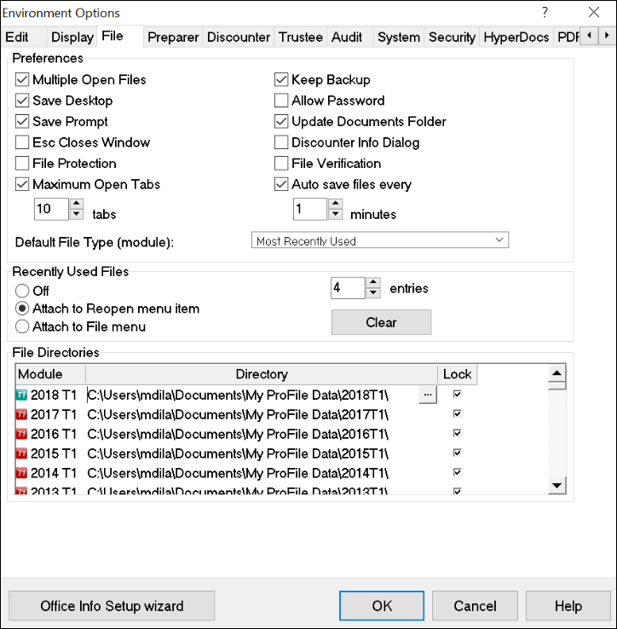
File Location
Multiple Files
Recently used files
File lock
page 15
file tab
Notes:
Discuss the File tab on Pg 15
DESCRIBE HOW TO CHANGE A FILE’S LOCATION AND HOW TO LOCK THAT LOCATION

Slide 10
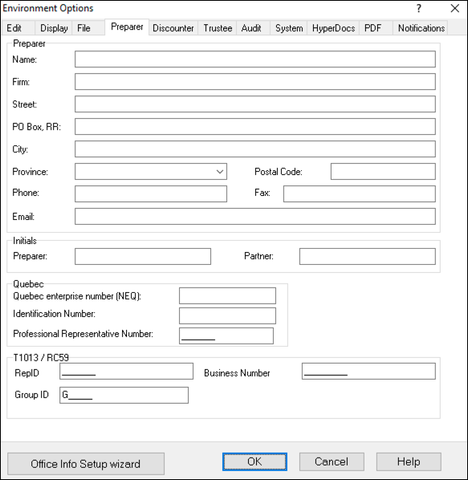
file preparer
page 16
setting it up
Notes:
Point out the Preparer settings on page 16
Explain how you can enter your CRA business number or RepID (for accessing client data at CRA’s website)
Also mention how you can use preparer initials to keep track of preparer and partner workflow

Slide 11
additional settings
Notes:
Mention how Page 18 introduces a host of other options to consider

Slide 12
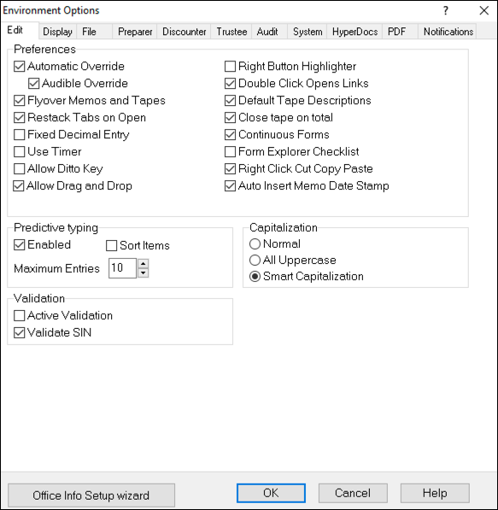
Manual override
Drag & drop
Validate SIN
Jump to a related field
Right-click
Smart Capitalization
page 18
Notes:
Describe the Edit tab on Page 18
Mention how you can set up options such as:
Manually override a calculated value on the tab return Use the Ditto key to quickly copy and paste the same information in adjacent fields Allow data to be dragged and dropped from one field to the next Ensure that every Social Insurance Number entered in ProFile is valid Double-click on a field in a tax return to jump to a related field Right-click to enable Cut, Copy and Paste

Slide 13
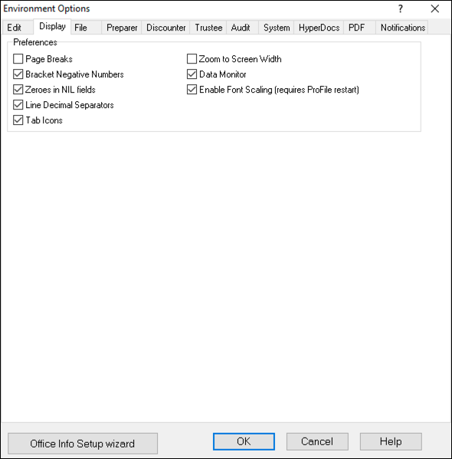
Page breaks
Zoom
Zeroes in NIL fields
Tab icons
Line decimals
Negative brackets
page 18
Notes:
Demo the display tab on page 18 and emphasize
Enable on-screen page breaks
Use brackets for negative numbers
Display zeroes for all NIL values
Automatically zoom the displayed tax file to full screen width

Slide 14
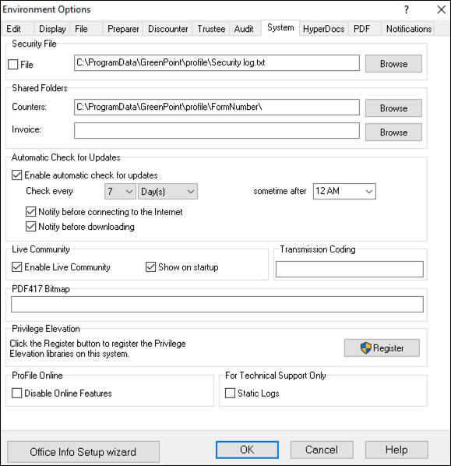
check for updates
online features
live community
page 19
Notes:
Discuss the Systems tab on Pg 19
Describe how you can establish the frequency in which ProFile checks for updates and you can also indicate whether you want ProFile to notify you before downloading and installing an update. Form the System tab, you can also:
Enable ProFile’s forum-like Live Community
Enable or disable ProFile’s online features

Slide 15
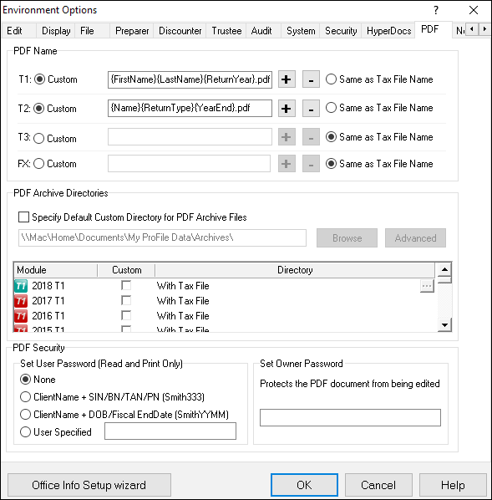
file naming
pdf passwords
file location
page 20
Notes:
Discuss the PDF tab on Pg 20
Describe how you can set file-naming conventions, as well as file location and password protection for all your PDF tax returns.

Slide 16
module options
Notes:
Mention how Module options differ from Environment options in that they are year and module-specific, thereby giving you a granular level of control over each type of tax return
ProFile’s Module options let you fine-tune the way ProFile works with each individual tax year and module (T1, T2, T3 and FX). This granular level of detail lets you determine the tax settings that ProFile will choose on new files, and on files you are carrying forward from a previous year. In this window, you can also establish your language preference, and you can set variance thresholds for comparing a client’s current and previous year’s tax file.

Slide 17
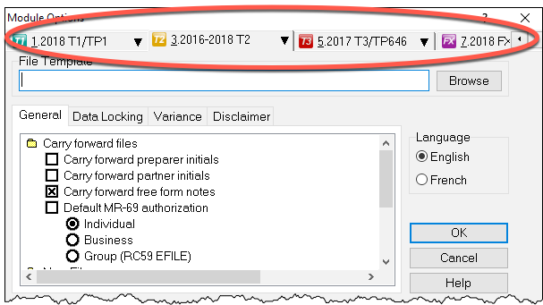
New file defaults
Carry forward defaults
Language options
page 20
Notes:
Refer to Page 20 and mention how you can scroll down this window to set defaults for new and carried-forward file. These defaults include RC 59 and T1013 authorization levels, pre and post-assessment review settings, and slip descriptions for carried-forward files. In this window, you can also:
Carry forward Elections Canada and foreign property questions, and T1DD information
Set defaults for language of correspondence and preparer information
Set client letter and invoice defaults
Establish naming conventions for your tax files
Choose form colours for client and spouse tax returns

Slide 18
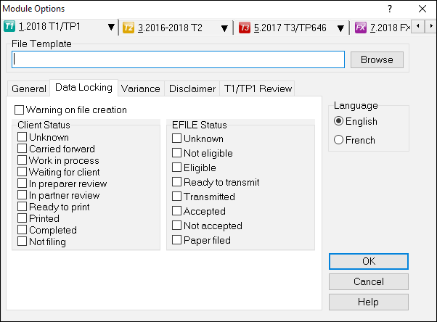
File creation warnings
Client status locking
EFILE status locking
page 22
Notes:
The Data Locking tab on Page 22 lets you enable a warning that prevents you from accidentally creating a tax file. You can also lock a file—and prevent additional data entry—once the Client and EFILE status that you indicate in this window is selected on a tax file. For example, if you click the Completed checkbox in the Client Status column, then ProFile will lock a tax file once a tax preparer indicates that the tax file has been completed.
Also refer to page 22 and describe how to set a file’s Client Status
To set a file’s Client Status, open a tax file and then go to File > Properties.
Click the Client Status dropdown and select the desired status
Note the checkbox, to the right of the Client Status dropdown, that lets you toggle file locking on and off

Slide 19
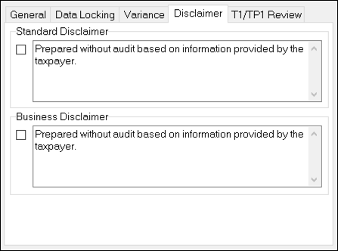
Standard disclaimer
GIFI disclaimer
page 23
Notes:
Refer to Page 23 and mention how you may want to add a standard business disclaimer to your tax files to alert readers as to your involvement with the information contained therein. ProFile lets you set two different disclaimers.
A general disclaimer, which will appear on the last page of the tax jacket, for the tax return as a whole
A business disclaimer that will appear on business-type forms such as the T2125 schedule for self-
employed individuals

Slide 20
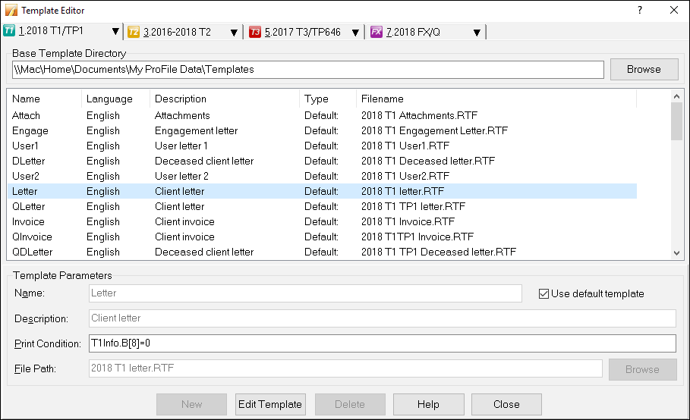
letters template
page 24
Notes:
Refer to Pager 24 and discuss how ProFile includes pre-formatted letters that you can print as part of your client’s T1 package. See Page 26 for a screenshot of a client letter
Also mention that all of ProFile’s preformatted letters are saved in a templates subfolder within the My ProFile Data folder. To view and edit any template, follow these steps:
Click on Options>Templates
Find and double-click the desired template, for example, Letter
Describe the difference between black and blue font as mentioned on Pg 25

Slide 21
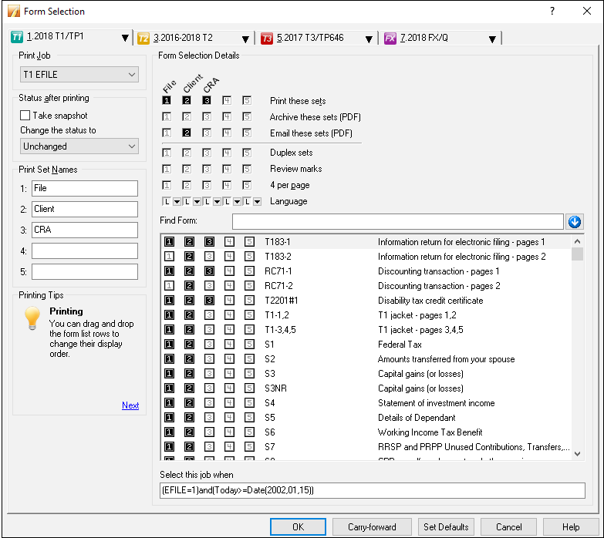
Module specific
Print job options
Default status
Environment - PDF
page 28
Notes:
Mention that this is perhaps one of the most important settings, in that it will help you save a great deal of time when it comes to printing/disseminating your client returns
Go over this in detail - as spelled out Pgs 28
Options>Forms Selection
EXPLAIN HOW TO DRAG FORMS UP OR DOWN (CLIENT LETTERS FOR EXAMPLE)
You can personalize the forms that you want to print for the client, your office, and CRA copies.
You can also tell Profile to change the file status after printing a return.
Note that you can add two extra print columns here as well, if you wish to print extra sets for whatever reason
Also mention how you can configure your print settings:
From the Options > Form Selection menu, choose the module and tax year
Choose the print job for the type of the tax return you are preparing for your client—the most common
print job being T1 EFILE
After printing a return, ProFile lets you choose a default status. For example, once printed, you might
want to set the status of all tax returns to Completed. The window below displays the available types of file status
Under Form Selection Details, you can choose the specific print set you’d like to prepare. For example, for each tax return, you can choose to print a copy for your files, your clients and for CRA. It’s here that you can also determine options such as duplex printing or four forms per page. You can also set
your PDF options here.
You can rename the prints sets, or add more print sets as well. To do either, just type the desired form
names under Print Set Names
Scroll through the Form window to select (or deselect) the forms you would like to save or send to
your clients
Click Carry-forward to assign last year’s print settings to the current year

Slide 22
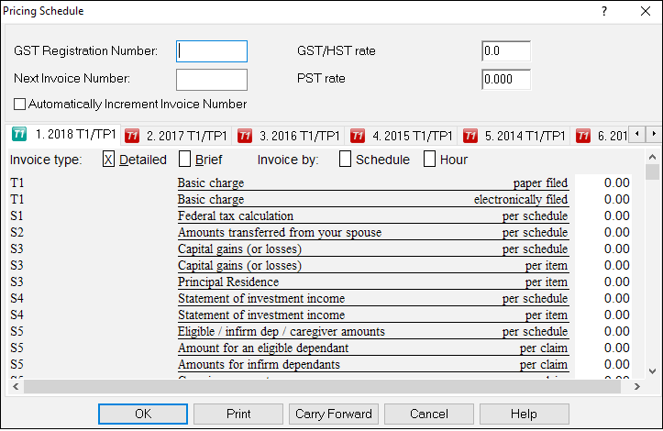
Module specific
Billing options
Detail or summary
Environment - timer
Page
28
Notes:
Describe the pricing options on page 28
Mention how you can:
Record your GST Registration Number and tax rates and you can set your invoice numbering sequence
Indicate whether you want to provide a detail or summary invoice to your clients Choose whether to bill by tax schedule or by the hour Establish your per-schedule pricing Carry forward last year’s pricing to the current year
Billing form and the Invoicing form (not in guide)
Mention the Environment options Edit tab and describe how you use ProFile’s timer

Slide 23
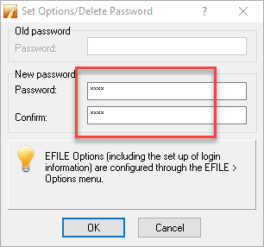
Secure your password
Tech support may not be able to restore it
page 31
Notes:
Describe the Options Password setting on Page 31
Emphasize how It’s important to safely record and store your options password as the ProFile support team may not be successful in helping you retrieve it.

Slide 24
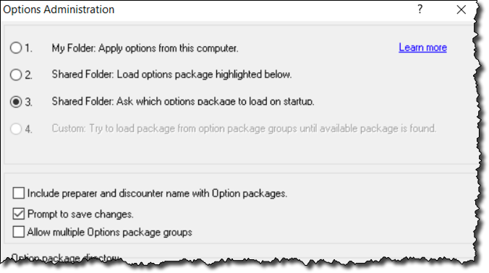
Options Administration
Save your settings
page 31
Notes:
Describe how to save your settings under Options > Administration (page 31-32)
Say something like this….
ProFile lets you save your customized global settings (those you enabled through the Options menu) in a folder that’s separate from the program files. This means if you upgrade or replace your computer, or if you reinstall ProFile, you can easily re-establish your customized options.
In addition, in a network environment, multiple users can point to one uniform options package that specifies settings such as data-file location and tax preparer information.
To view where ProFile stores your global settings, click Options and select Options Administration.
The window below tells you your settings are stored in an Options Package folder.
To save your customized settings click New.

