Slide 1
Learning about Taxes with Intuit ProFile

Slide 2
Chapter 4 A Basic T1

Slide 3
In this Chapter
Paper VS ProFile
An individual T1
A Spousal T1

Slide 4
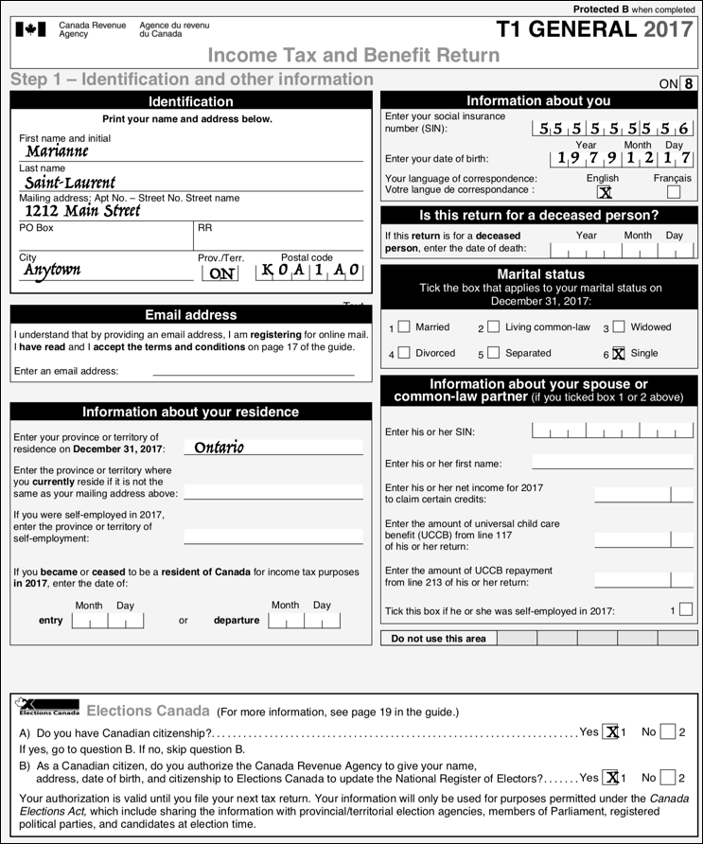
What’s a T1?
Notes:
Refer to Page 5 and explain that a T1 is a personal tax return (just as a T2 is a corporate return and a T3 is a trust return)

Slide 5
complex
error-prone
time-consuming
Page 6
a paper t1
Notes:
Refer to page 6 and describe the complexity of hand-written T1s. You need:
To know which forms to complete
To make complex calculations
To transfer amounts manually amongst various forms

Slide 6
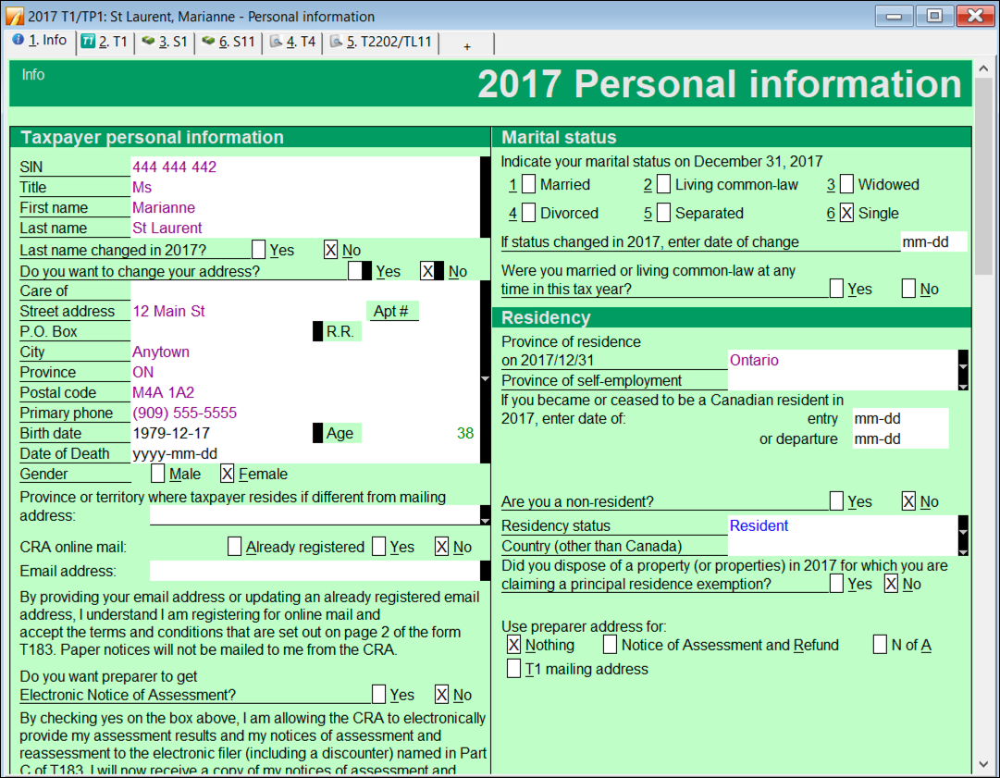
INFO page
Page 9
a ProFile t1
Notes:
Introduce ProFile prep and describe how all contact info goes on the INFO page (Page 9)

Slide 7
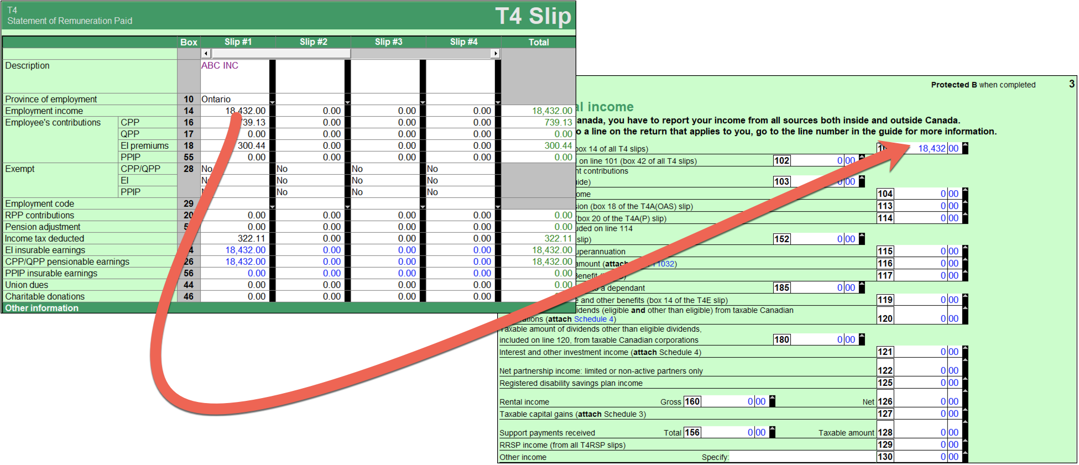
Automatic calculation
Slip-entry
T1 jacket prep
page 10
a ProFile t1
Notes:
Refer to page 10 and describe how you use Forms and Schedules to fill out slips
And that ProFile then
Makes all necessary calculations
Transfers the necessary amounts to the required forms
And finally transfers everything to the T1 Jacket

Slide 8
paper VS ProFile
page 12
t1 prep
Notes:
Refer to page 12 for conclusions
ProFile—at least with a basic T1—provides guided tax preparation that requires you to simply enter information on the required forms and slip (in this example T4 and T2202) and ProFile will then complete the T1 based on those entries.
Contrast that with the same hand-written example, and the benefits gained by using tax-preparation software are immediately evident.

Slide 9
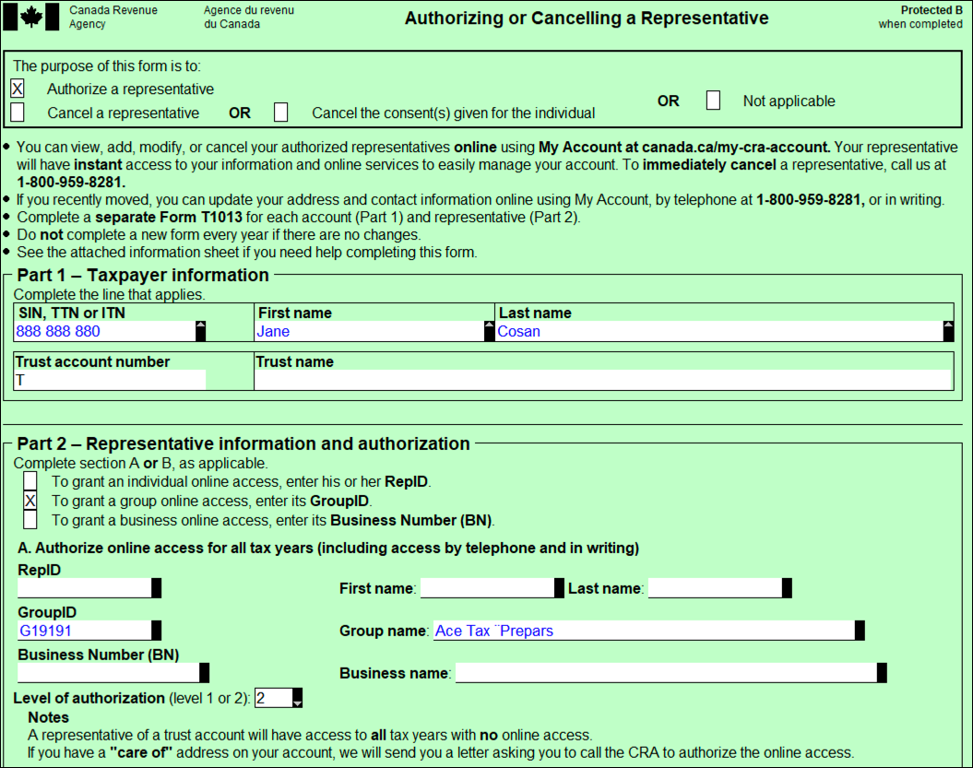
a tax practitioner approach
T1013
spousal return
page 12
t1 prep
Notes:
Refer to page 12 and discuss how a tax practitioner goes about preparing a T1—In this example, a spousal T1
Go to pages 13 and discuss the T4s, T5, and donations
And then go to Page 14 to describe how to setup a spousal T1 in ProFile
Mention the importance of a T1013 (Page 14), and describe the steps in logging onto CRA’s Represent a client website

Slide 10
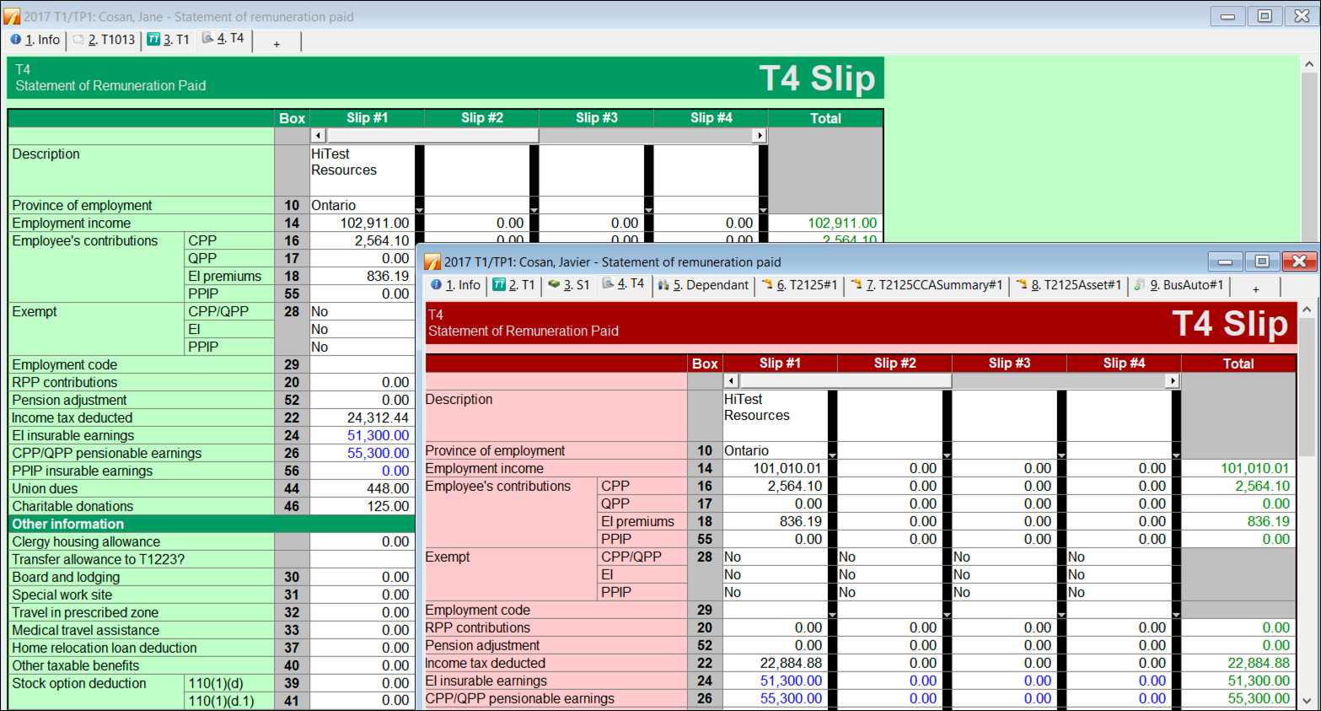
data entry
spousal toggle
slip summary
page 15
t1 prep
Notes:
Refer to page 15 and discuss how you enter tax data on each spouse’s T1 (mention the Toggle icon and the F5 key)

Slide 11
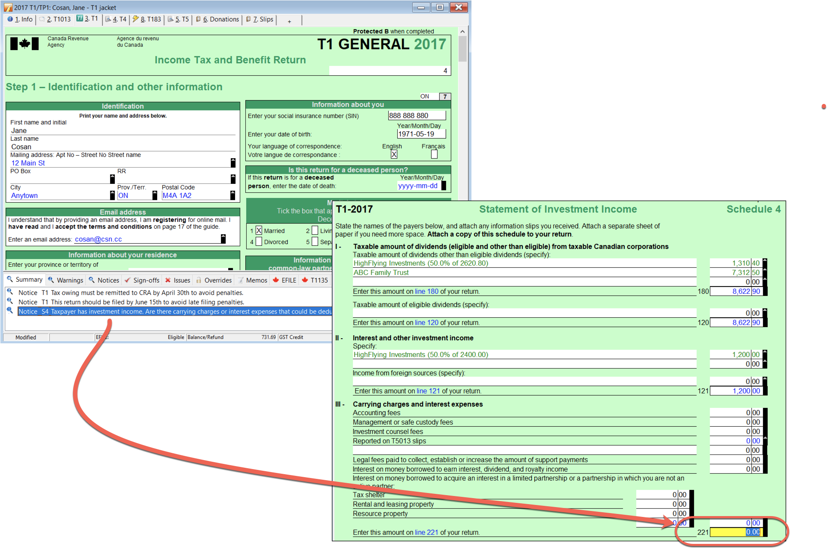
the auditor
page 20
Notes:
Refer to page 20 discuss how you work with the auditor to verify the T1s

Slide 12
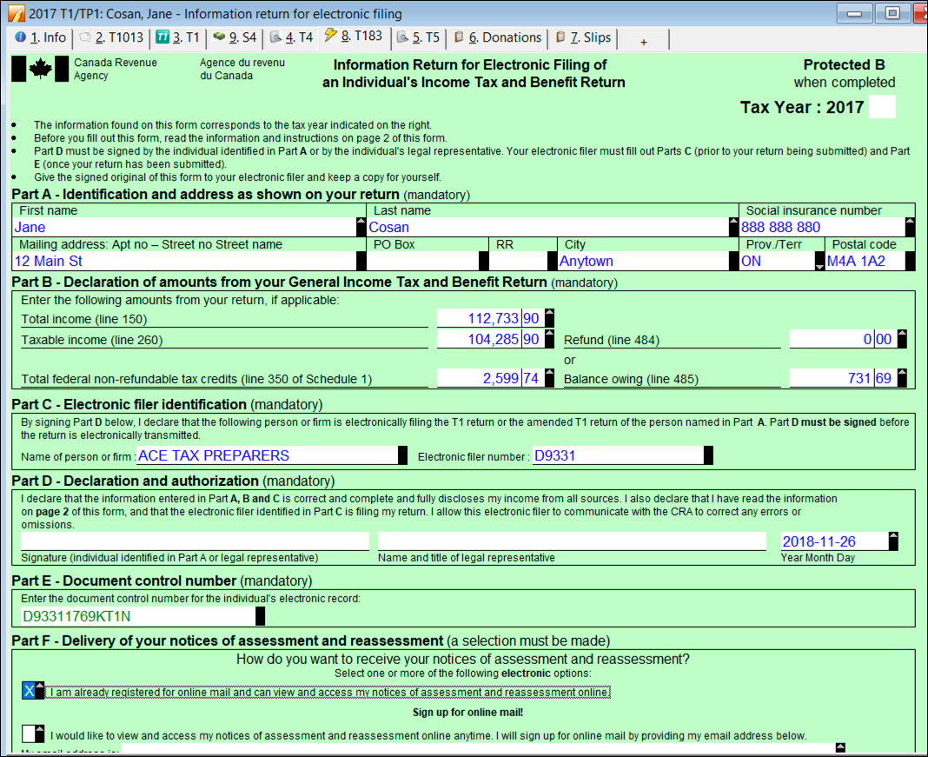
print / pdf
t183
EFILE
page 22
t1 prep
Notes:
Refer to page 22 and mention how you can then Print/PDF the T1
Discuss the importance of a T183
Describe how to EFILE the returns

