Slide 1
Learning about Taxes with Intuit ProFile

Slide 2
Chapter 1 All about taxation

Slide 4
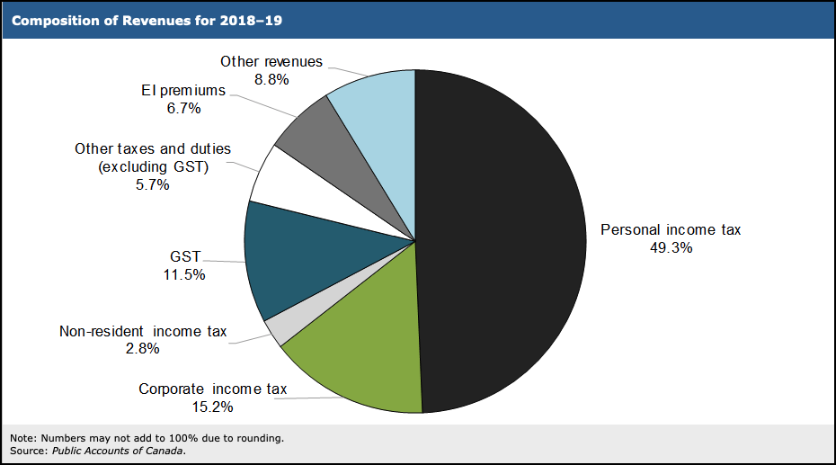
What are taxes?
How are our tax dollars spent?
Characteristics of a tax system
Source: https://www.fin.gc.ca/afr-rfa/2019/report-rapport-eng.asp#_Toc525903642
Notes:
Refer to Page 7 and discuss
- Who collects tax
The programs paid by direct taxation
Refer to Page 9 and discuss
- Characteristics of a tax system

Slide 5
A history of taxation
1916
Business Profit War Tax
1917
Income War Tax Act
1927
Department of Revenue
1952
Old Age Security Act
1991
GST
2007
Taxpayer Bill of Rights
Notes:
Refer to Page 10 and discuss
History of world taxes
Canadian taxation before confederation
1916: Business Profit War tax
1917: Income War Tax Act
1927: Department of Revenue founded
1952: Old Age Security Act
1991: GST implemented
2007: Taxpayer Bill of Rights

Slide 6
Types of tax
Source deductions
Refunds?
Income tax
CPP
EI
Sales tax
Amounts withheld at source by employers
Too much tax withheld
Excess instalments
Tax credits
Notes:
Refer to Page 9 and discuss
Different types of tax
Source deductions defined
What triggers refunds?
Too much tax withheld
Excess instalments
Tax credits
Refer to Page 12 and discuss
- Characteristics of a tax system

Slide 7
About the CRA
Administer tax, benefits & programs
CRA website
CRA programs
CCB
Tuition credit
RESP & RRSP
https://www.canada.ca/en/services/taxes/income-tax.html
Notes:
Refer to Page 13 and discuss
About the CRA
Administers tax, benefits and programs
CRA website
CRA programs

Slide 8
CRA information
Employers, financial institutions, review of tax returns, assessment programs
Tax filing
Filing options
NetFile
EFILE
Paper
All income earners
Taxpayer responsibilities
Filing obligation
Self-assessment
Paying correct amount
Notes:
Refer to Page 15 and discuss
How CRA obtains information
Employers, financial institutions
Review of tax returns
Assessment programs
Refer to Page 17s and discuss
Who should file a tax return
Filing options include Paper; NetFile and EFILE
Refer to Page 16 and discuss what happens after you file
Notice of Assessment
Four – Six weeks if paper filed
Two weeks if electronically filed
Refer to Page 17 and discuss taxpayer responsibilities
Obligation to file and pay tax
Self-assessment

Slide 9
End

