Slide 1
Learning about Taxes with Intuit ProFile

Slide 2
Chapter 3 A Tour of ProFile

Slide 3
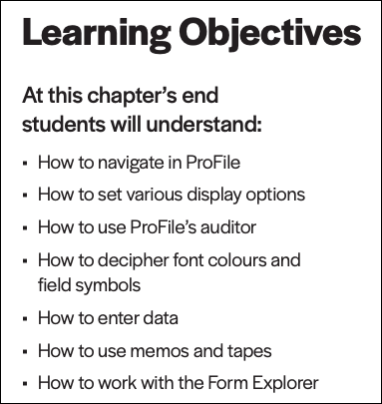

Slide 4
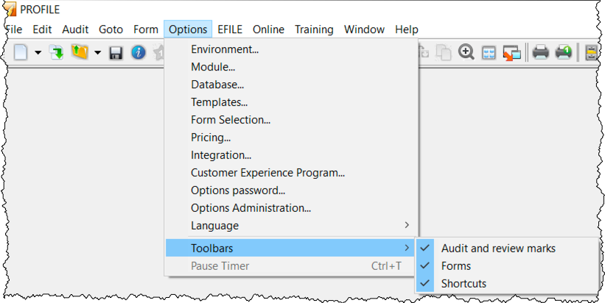
tabs
jump to forms
menu bar
toolbars
manual navigation
quick icons
page 5
a tour of ProFile
Notes:
Refer to page 5 and discuss
Tabs
Every time you create a tax return, ProFile displays a tab for each open form. You’ll see the tabs just above the form you’re currently working in, and you can navigate to any open form by clicking its tab.
Menus
As with all software applications, you can use the Menu Bar to navigate in ProFile. With its extensive set of menu commands, you can, for example, create or open tax files, setup preferences, arrange windows, and jump to specific areas of a tax file
Toolbars
Toolbars are a set of icons that let you quickly and easily move around in ProFile. There are three configurable toolbars that you can enable (or disable) in ProFile.
You can view the three available toolbars by clicking Options>Toolbars
The three toolbars are: Audit and review marks, Forms and Shortcuts

Slide 5
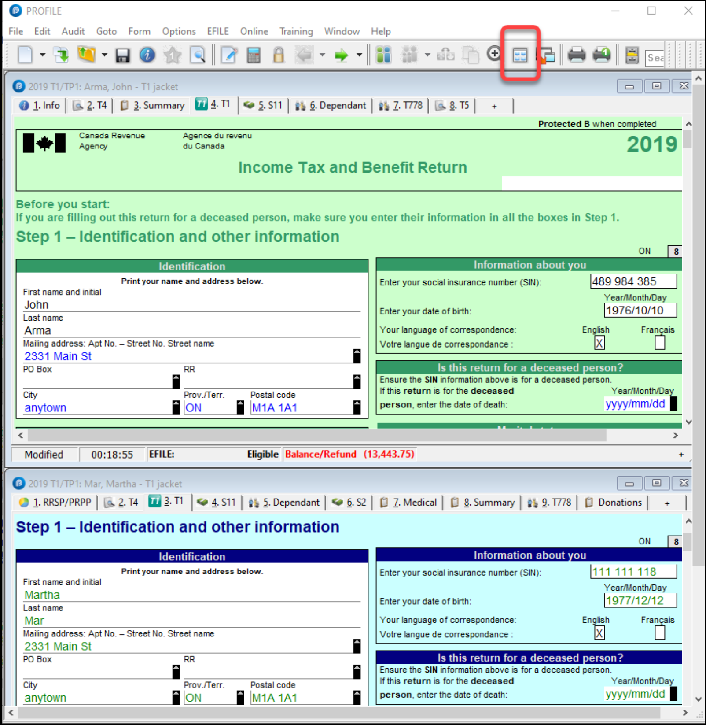
tile
display multiple files
launch
window menu
multiple monitors
quick icons
page 7
display options
Notes:
Refer to page 7 and discuss ProFile’s display options including
Tiling windows
Click the Tile icon to view two tax files, tiled horizontally one above the other
Launch windows
If you use multiple monitors, you can display one file on each screen, Click the Launch icon to create a floating window for the second file, and then then drag it over to your second monitor
The Window menu
You can also use the Window menu to cascade, tile or manually arrange your open windows

Slide 6
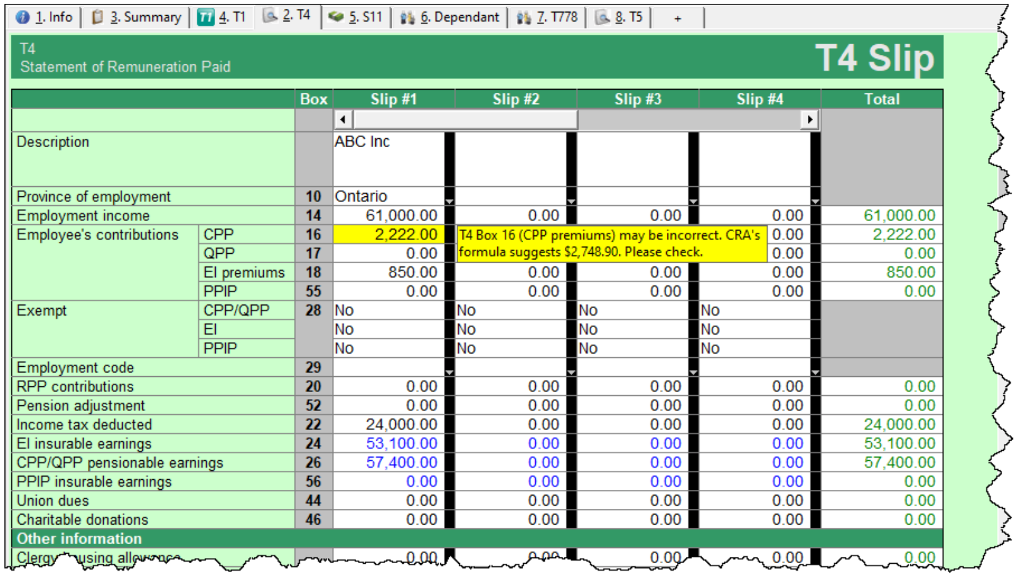
the auditor
Page
8
auditor
Notes:
Refer to page 8 and mention that ProFile comes with a comprehensive auditor that constantly scans a tax file and alerts you to missing or erroneous information. ProFile’s auditor also makes suggestions for optimizing a tax return, and it reminds you about memos you may have entered, amounts you may have calculated, or review marks that you annotated on a tax return.

Slide 7
passive auditor
Page 8
auditor
Notes:
Refer to page 8 and mention that...
The Passive Auditor’s constantly scans the return and, when it detects a potential error, highlights that area of the tax file with a yellow background. When you move your cursor over that yellow field, the passive auditor opens a context-sensitive message.
Example of passive audit messages include
Missing data that is necessary for filing
Missing EFILE information
Amounts on tax slips that fall outside the tolerance range (as in the CPP example above)
Opportunities for additional claims (for example, the taxpayer is eligible for a disability amount)
Claims that may be more beneficial on a spouse’s return
Filing requirements specific to a return (taxpayer subject to minimum tax)
Suggestions to reduce a claim (excessive RRSP deduction or unnecessary CCA claim)
Planning opportunities
Other forms or elections that may be necessary but have not been included in the tax file

Slide 8
the active auditor
auditor
Page 9
Notes:
Refer to page 9 and mention that the Active Auditor displays a list of audit messages that apply to the current tax file. These include passive audit messages mentioned above, as well as notices or processing errors, EFILE messages, fields with memos or calculations attached, overridden fields, or fields with review marks attached.
To display the Active Auditor, click its toolbar icon
Note the tabs in the audit window. These tabs include:
Warnings that indicate potential processing problems, including messages about data may have been
overlooked— for example, a slip with no recorded information
Notices that alert you to important dates or deadlines. Notices also alert you to amounts that fall outside
a calculated range
Sign-offs which display Review Marks that a partner or tax preparer added to the tax return
Issues for any field that has a correction or question review mark attached to it
Overrides that alert you to a change that you made to a field’s calculated amount
Memos to remind you that you attached a note to a field in the tax file
EFILE warnings to prevent you from EFILING a tax file. In addition, any messages originating from
CRA, after an EFILE was processed, will appear here.
Carry forward that lists all the data brought forward from a prior year’s return
Tapes that highlight a field where ProFile’s calculator was used
Variance that highlights any changes made after you took a snapshot of the tax return
Data Import that lists taxpayer data imported using CRA’s Auto-fill My Return
Summary which consolidates all messages from the other tabs.
Acting on audit messages
To act on an audit message, double click the message.
ProFile will open the applicable form, circle the item and add a yellow background to the field

Slide 9
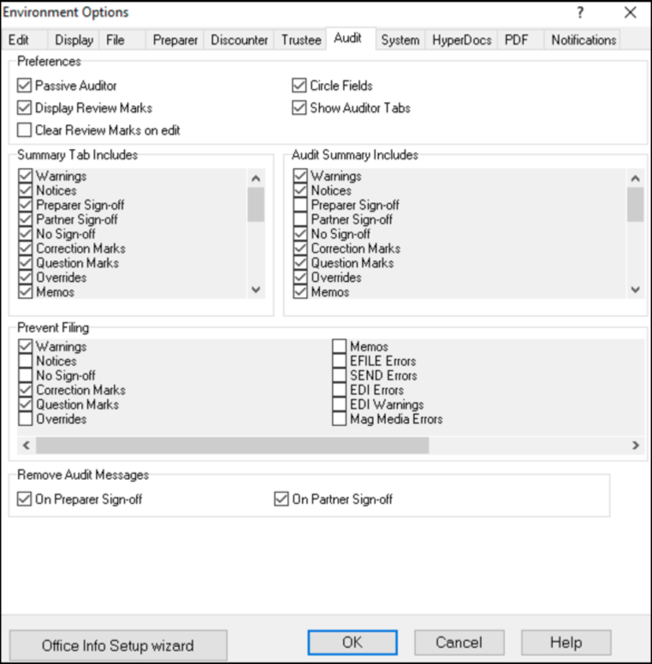
personalizing the auditor
page 11
auditor
Notes:
Refer to page 11 and mention that the Audit tab, also found under Options>Environment, lets you choose how you’d like to work with ProFile’s Auditor. From this window, you can:
Enable or disable features such as the Passive Auditor, review marks and circled fields •Choose the information to display on the Summary Tab of the Active Auditor
•Determine the audit messages that will prevent ProFile from EFILING a return •Remove audit messages on partner or preparer sign-off

Slide 10
putting it all together
Notes:
This section starts on page 12

Slide 11
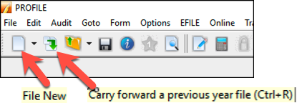
getting started
new / carry-forward
info page
data entry
contact & other personal info
quick icons
pages 12-13
getting started
Notes:
Refer to page 12 and discuss how, invariably, you will start by either creating a new tax return or carrying forward a file from the previous year, and you accomplish either of those tasks by clicking the appropriate icon on the toolbar.
Also note that ProFile opens a tax file at the Personal Information page. This is where you enter the taxpayer’s
contact information, as well as residency, marital status and other information
ProFile automatically opens other forms and schedules, such as the T1 Jacket. You can tell which forms ProFile opens by glancing at the forms’ representative tabs
And mention that even though ProFile automatically opens the tax jacket, it’s important to note that you enter data on supporting forms and schedules, and not directly on the jacket itself.
For example, when you click on the T4 tab (from the window above), ProFile will launch the T4 Slip window which, after you enter an employee’s earnings, will look like this

Slide 12
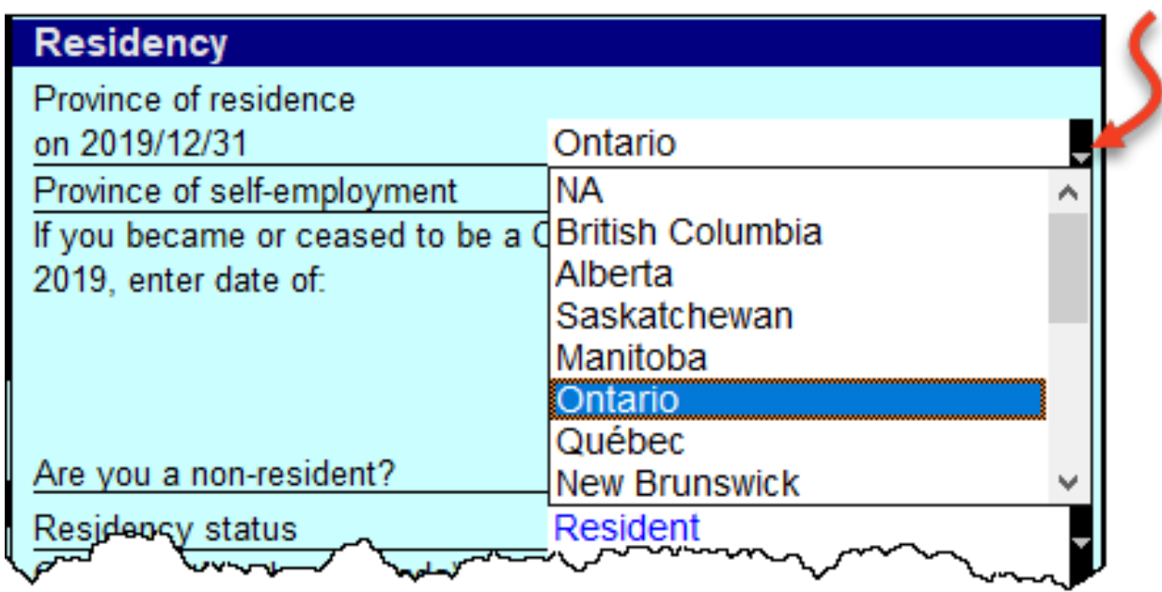
data entry
colours
font colours
arrows & diamonds
overrides
contact & other personal info
manual entry
page 13
Notes:
Refer to page 13 and discuss how, fields might have different font colours. Here’s what those colours signify:
Fields with...
Purple fonts denote data carried forward from a prior year
Black fonts are for direct data entry
Blue fonts indicate a field calculated by ProFile
Red fonts mean that you overrode a calculated field
Green fonts denote a row or column total
The right edge of certain fields may display an up-arrow, a down-arrow, or a diamond. Here’s what those diagrams signify:
If a field displays a down arrow, then a dropdown menu exists for that field
When a field displays an up arrow, it means the data in that field originates from another form. In addition, ProFile displays amounts in those fields in blue font
When a field has an up-arrow view, double-click it (or press F6) and ProFile will jump to the referenced form
If you decide to override a calculated field, ProFile does two things; it displays a red diamond in that field, and it also displays the overridden amount in red font.

Slide 13
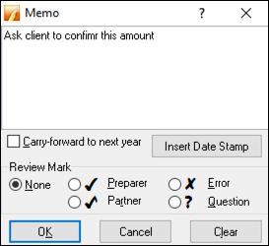
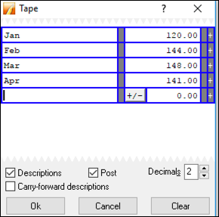
memos
entering notes
tapes
making calculations
Page
15
data entry
Notes:
Refer to page 15 and discuss how ProFile’s memos are great for embedding notes and reminders into any field on a tax return. And you can use ProFile’s calculator to add up a series of numbers and enter the total into any field of the tax return.
Using Memos
To record a memo, click into any field
Press the F8 key
Type in your note
Click OK
Using Tapes
To use Tapes, click on a field
Press CTRL+F8
In the window that opens, enter a description (optional), and a value on each line
Press the = key and ProFile will paste the sum directly into the selected field
Note that When you record a memo, or use a tape in a field, ProFile puts a green background in that field. To display the underlying memo or tape, just hover your mouse over that field

Slide 14
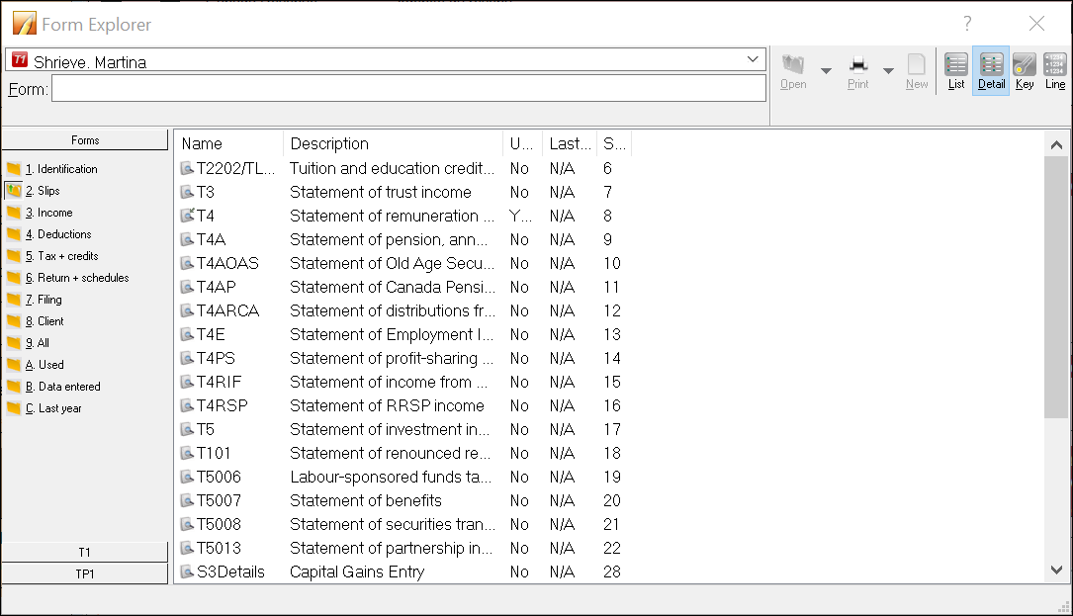
form explorer icons
right-click
find what you need
page 17
form explorer
Notes:
Refer to page 17 and discuss the Form Explorer
When preparing a tax return, you will, of course, want to work with additional forms and schedules. And, given you don’t enter data directly on the tax jacket, this means you have to find those supporting forms and schedules somewhere in ProFile.
Though ProFile’s toolbar includes a Search field that lets you enter the name of the form or schedule that you need, you may want a little more horsepower than that. You may indeed want to use The Form Explorer.
To open the Form Explorer, click on the Filing Cabinet icon, or just press your keyboard’s F4 key
If you use Windows Explorer TM, you’ll be comfortable with ProFile’s Form Explorer
The right pane of the Form Explorer window includes column headings for each form’s full name, its
category, and its description
Notice, too, for carried forward files, the Form Explorer indicates whether a form was used in the
current or prior year
In the left pane, you’ll find folders that let you filter which forms to display
To find a form, just type its name in the search field
Form Explorer Icons
There are four icons at the top right of the Form Explorer window. These icons provide view options. The bullets below explain each icon’s purpose:
As the name implies, the Detail view provides complete information, such as category and description, for each form.
The List view gives you a simplified view where all forms are displayed as icons.
The Key view lets you use keywords to find the required form. This view is ideal when you know what
information you’re searching but you’re not sure of the form’s name.
Lastly, the Line view provides a line by line listing of all available forms. You find a form, in this view,
by entering a tax line number in the Form field

Slide 15
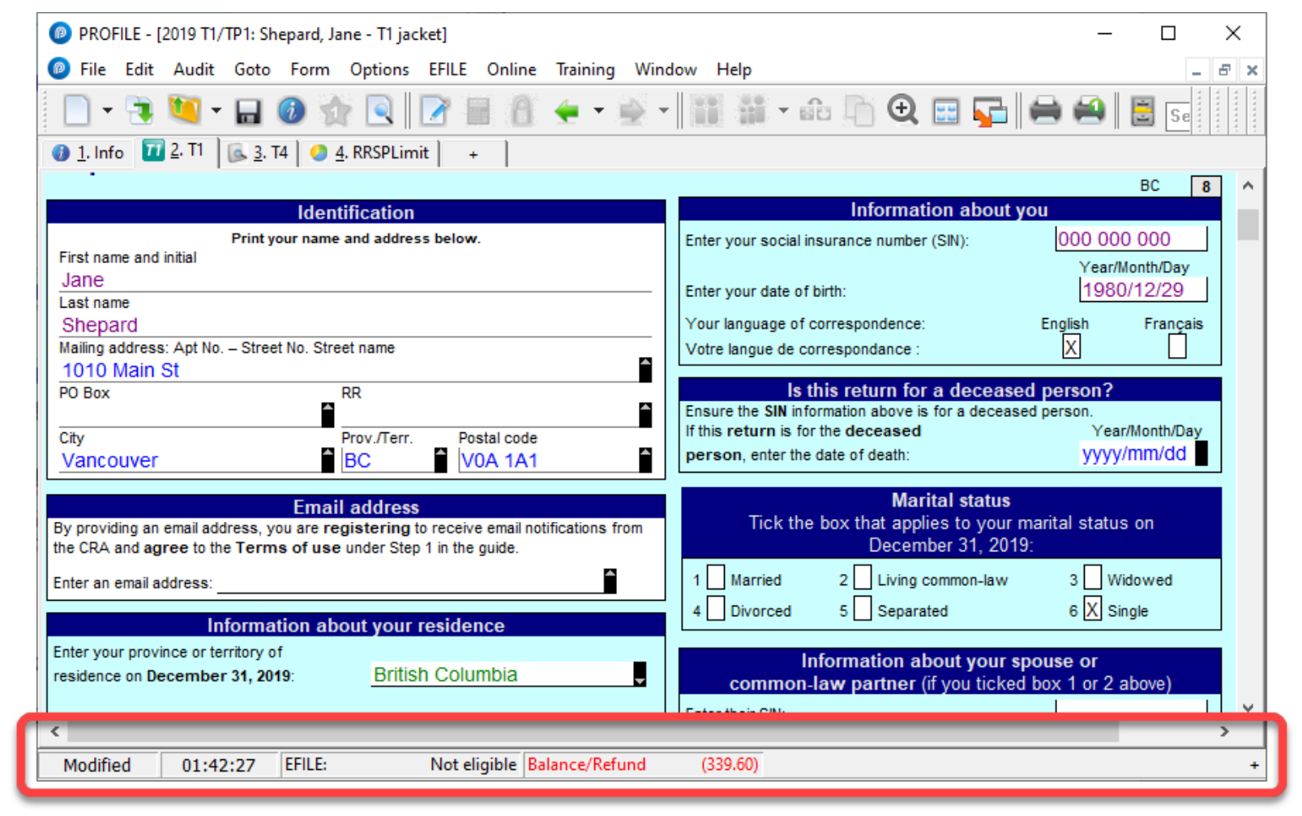
data monitor
page 18
Notes:
Refer to page 18 and discuss how to use and customize the Data Monitor
As you add information, and append more forms to the return, ProFile constantly updates the taxpayer’s tax status. At the very bottom of the window, ProFile displays an at-a-glance summary of the taxpayer’s tax status
Customizing the Data Monitor
You can customize and add information to the Data Monitor.
For example, to display line 150, just highlight it
Click the “+” sign at the bottom of the window
You have just added Line 150 to the Data Monitor

Slide 16
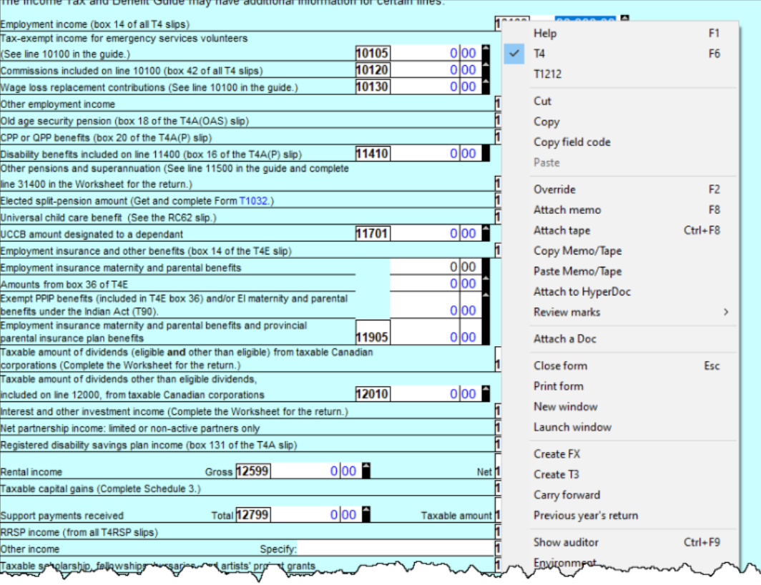
Power of a right-click
page 20
Notes:
Refer to page 20 and discuss the power of a right-click
Right-click over a blank area of a form, and ProFile gives you a set of instructions including Print, Carry forward, Close, and Copy Memos and Tapes
You can also jump to specific areas of that form and, for carried-forward files, you can also launch last year’s tax return
If you right-click on a field, you’ll see additional commands, including Cut, Copy, Paste, as well as Insert/Delete columns and Attach Memo/Tape
When you right-click over a blank area, or in a field, of the T1 Jacket, you can jump to specific areas of the tax file

Slide 17
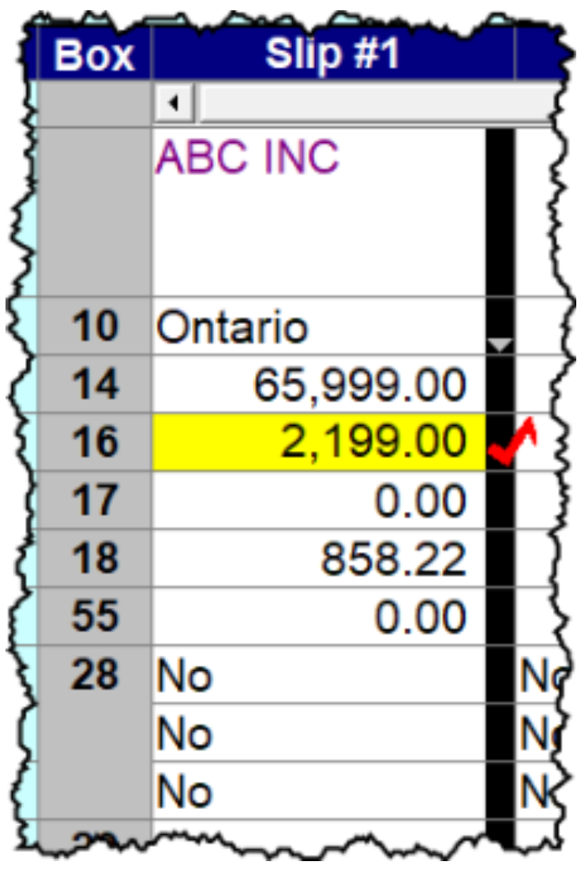
review marks
page 21
Notes:
Refer to page 21 and discuss review marks
Review Marks let you or approve, or request changes on, any field of a tax file. There are four different types of Review Marks.
Use the Preparer Sign-off to confirm the amounts entered on each line of a return, or to approve any errors or issues signaled by the Passive Auditor
The Partner Sign-Off is similar to the Prepare Sign-Off, except that it’s used in an office where a supervisor or partner approves all returns
Use Correction Required to flag a field error on the return
• Use the Question Mark to tag a field for further analysis

Slide 18
End

