Slide 1
Learning about Taxes with Intuit ProFile

Slide 2
Chapter 5
Advanced T1 Work

Slide 3
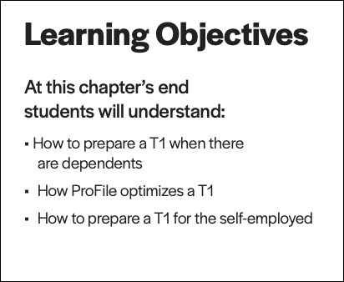

Slide 4
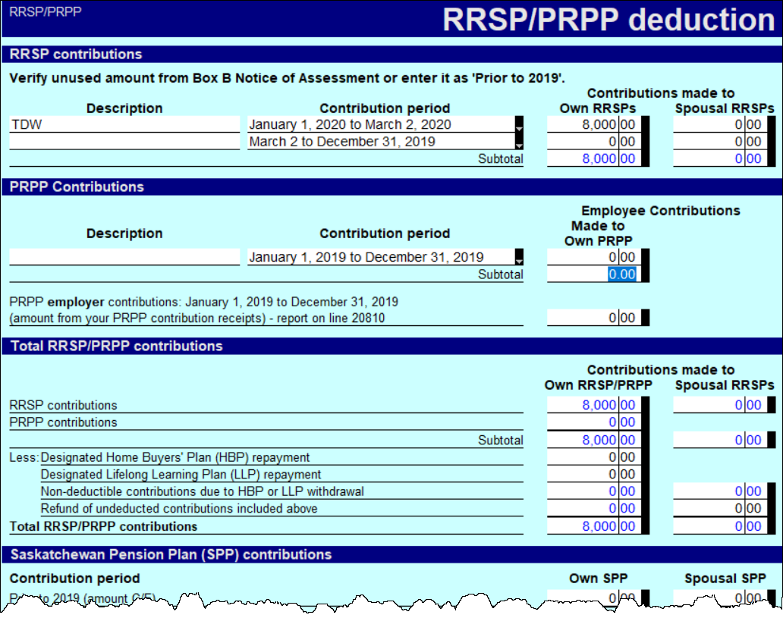
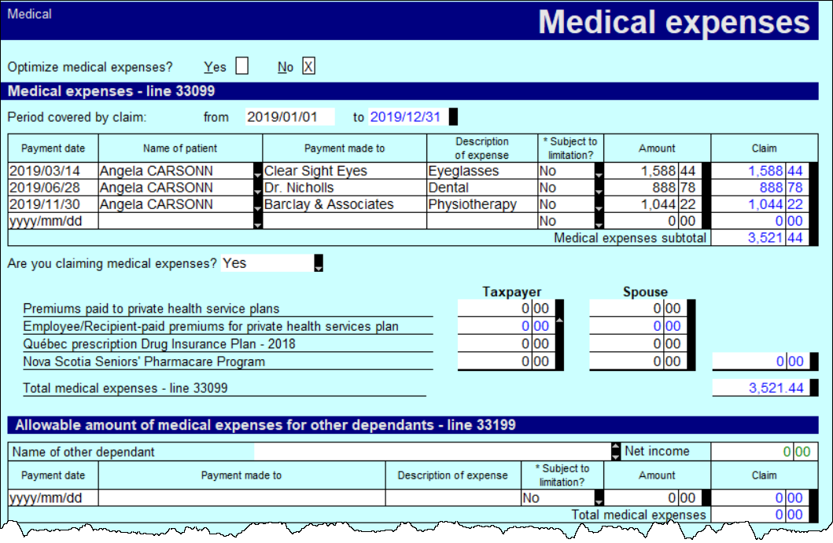
rrsp
medical expenses
Page 7
advanced t1
Notes:
Refer to pages 7-9 and discuss
- Recording RRSP slips and medical expenses

Slide 5
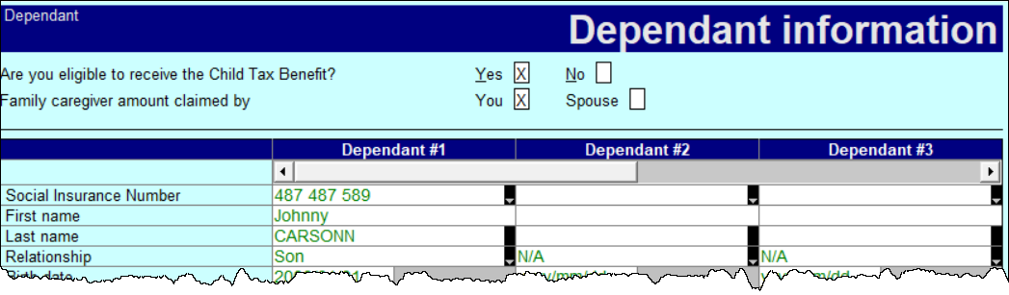
family linking
dependants
tuition
Page 8
advanced t1
Notes:
Discuss
Creating a dependant’s return – page 8
Tuition transfers - Page 10

Slide 6
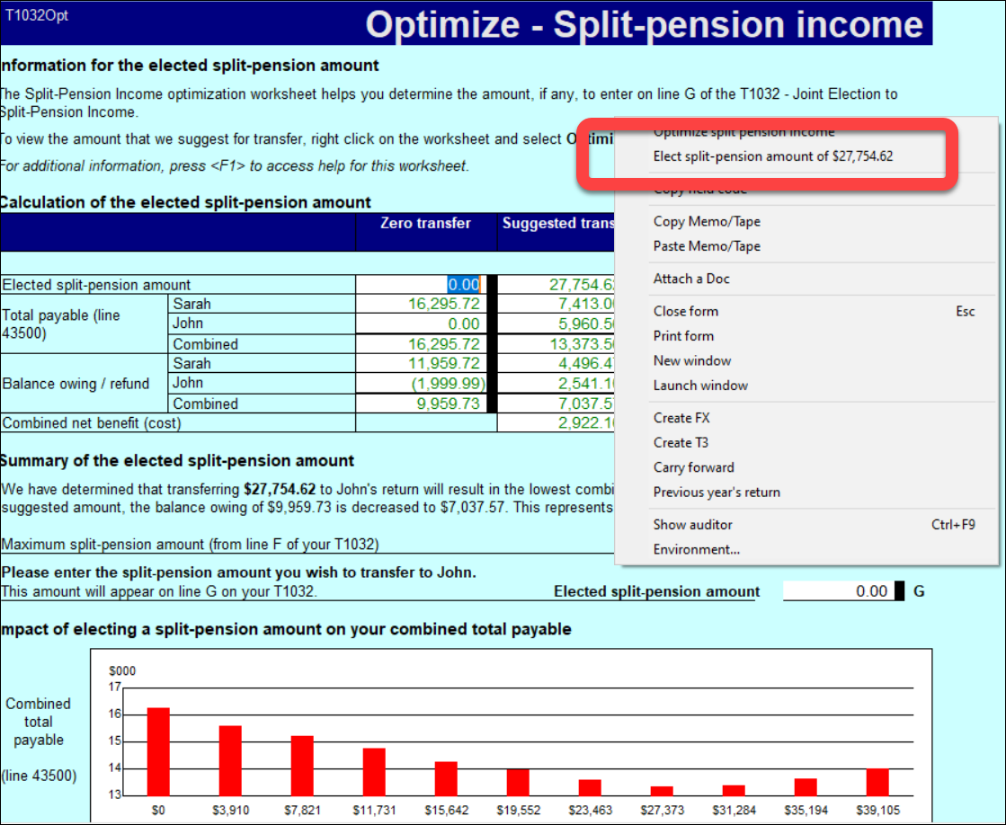
optimizing
pension splitting
Page 11
advanced t1
Notes:
Refer to Pages 10-12 and discuss
Optimizing – P10
Pension splitting – P11

Slide 7
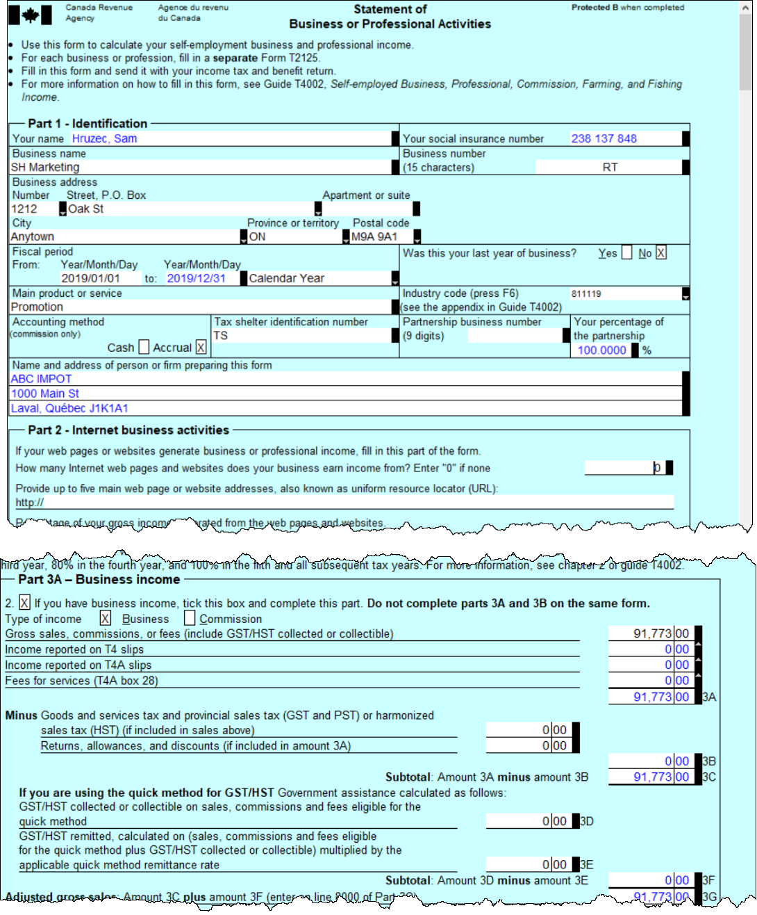
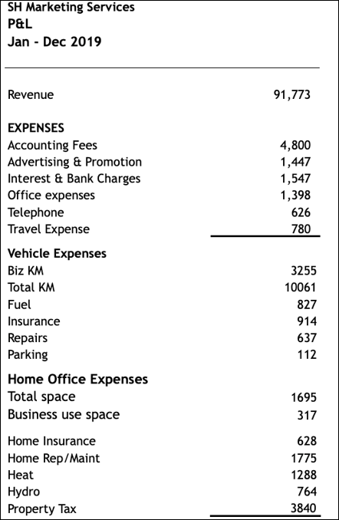
P&L - T2125
vehicle
home office
page 13
the self-employed
Notes:
Refer to page 13 and introduce a T2125 for the self-employed
Describe the P&L at page 13 and the T2125 at Page 14
Go on to Page 15 and discuss the way in which vehicle expenses are entered
And also discuss home-office expenses

Slide 8
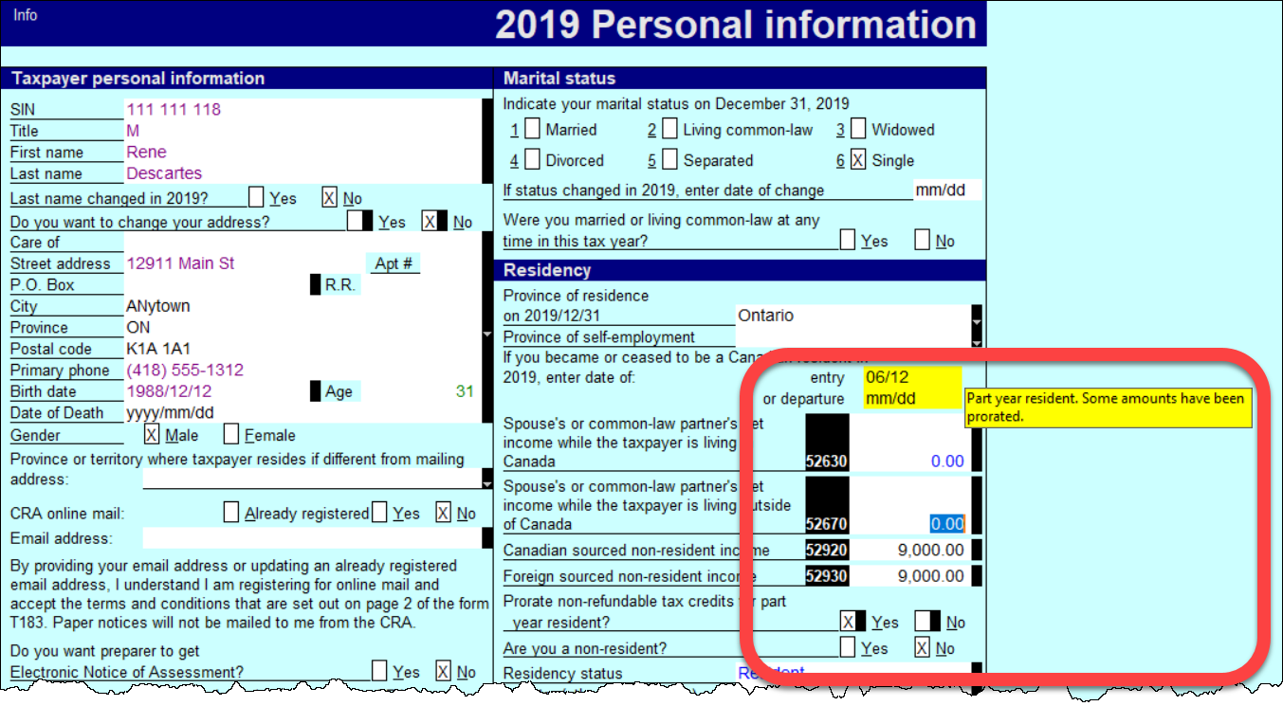
Part-year residents
Cdn non-res income
Foreign non-res income
date of entry
Page 17
part-year residents
Notes:
Discuss Part-year residents – at pages 17

Slide 9
End

