Slide 1
Learning about Taxes with Intuit ProFile

Slide 2
Chapter 6
An Online World

Slide 3
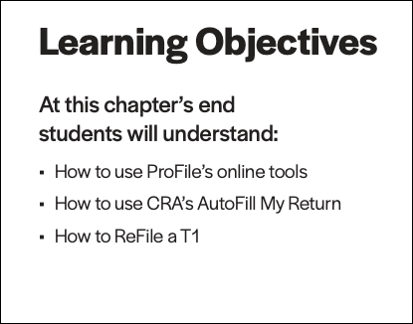

Slide 4
an online world
Notes:
Refer to Page 5 and discuss how everything’s going online
Every day, more and more businesses are taking things online. Online stores; online information; online payments; online communication—all are part of our everyday lives. It should come as no surprise, then, that tax preparers too are increasingly using cloud tools. Canada Revenue Agency, for example, demands that tax preparers EFILE tax returns and, at the same time, with a dedicated Represent a Client account, CRA gives tax preparers online access to an array of client information that was unthinkable just a few short years ago. ProFile is accentuating this cloud trend as well. As a ProFile user, you have access to an increasing number of cloud tools.

Slide 5

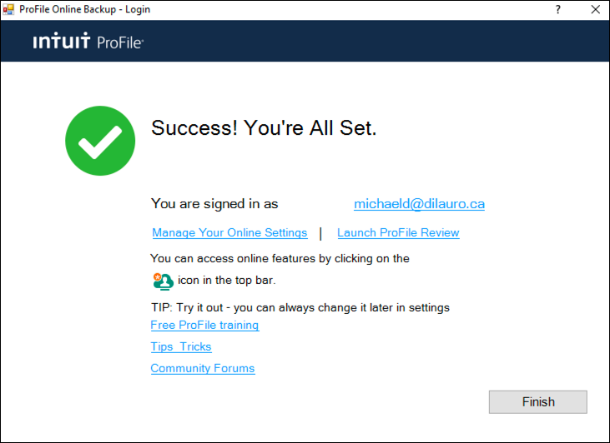
accessing
live chat
notification centre
online setting
online toolbar
Pages 5-9
an online world
Notes:
Refer to pages 5-9 and describe the icons on the online toolbar
Point out how to create and/or access your online account - Pp 8-9

Slide 6
autofill my return
Notes:
Refer to page 9 and introduce CRA’s AFR
AutoFill My Return (AFR) is a secure Canada Revenue Agency (CRA) service that allows individuals and authorized representatives to automatically fill-in parts of a T1 return with information that the CRA has available at the time of filing the return. Many authorized representatives are already accessing CRA’s online services to gather client information. AFR is the logical next step. By filling in key tax data, CRA’s AFR simplifies the tax preparation process

Slide 7
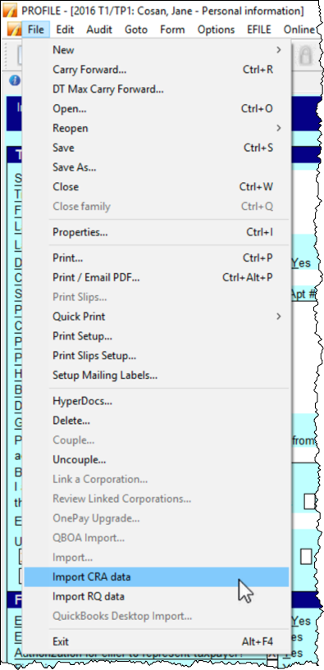
What is it?
Signed Authorize a Rep
What's required?
Auto-populate tax fields from CRA site
Rep a client access
Page 9
autofill my return
Notes:
Refer to page 9 and mention what AFR does and how you use it
Mention the requirements
Must be an authorized representative (Represent a Client ID and password)
T1013
Refer to Page 10 that describes how to launch AFR
Go to File > Import CRA Data
Click > Launch CRA Website

Slide 8
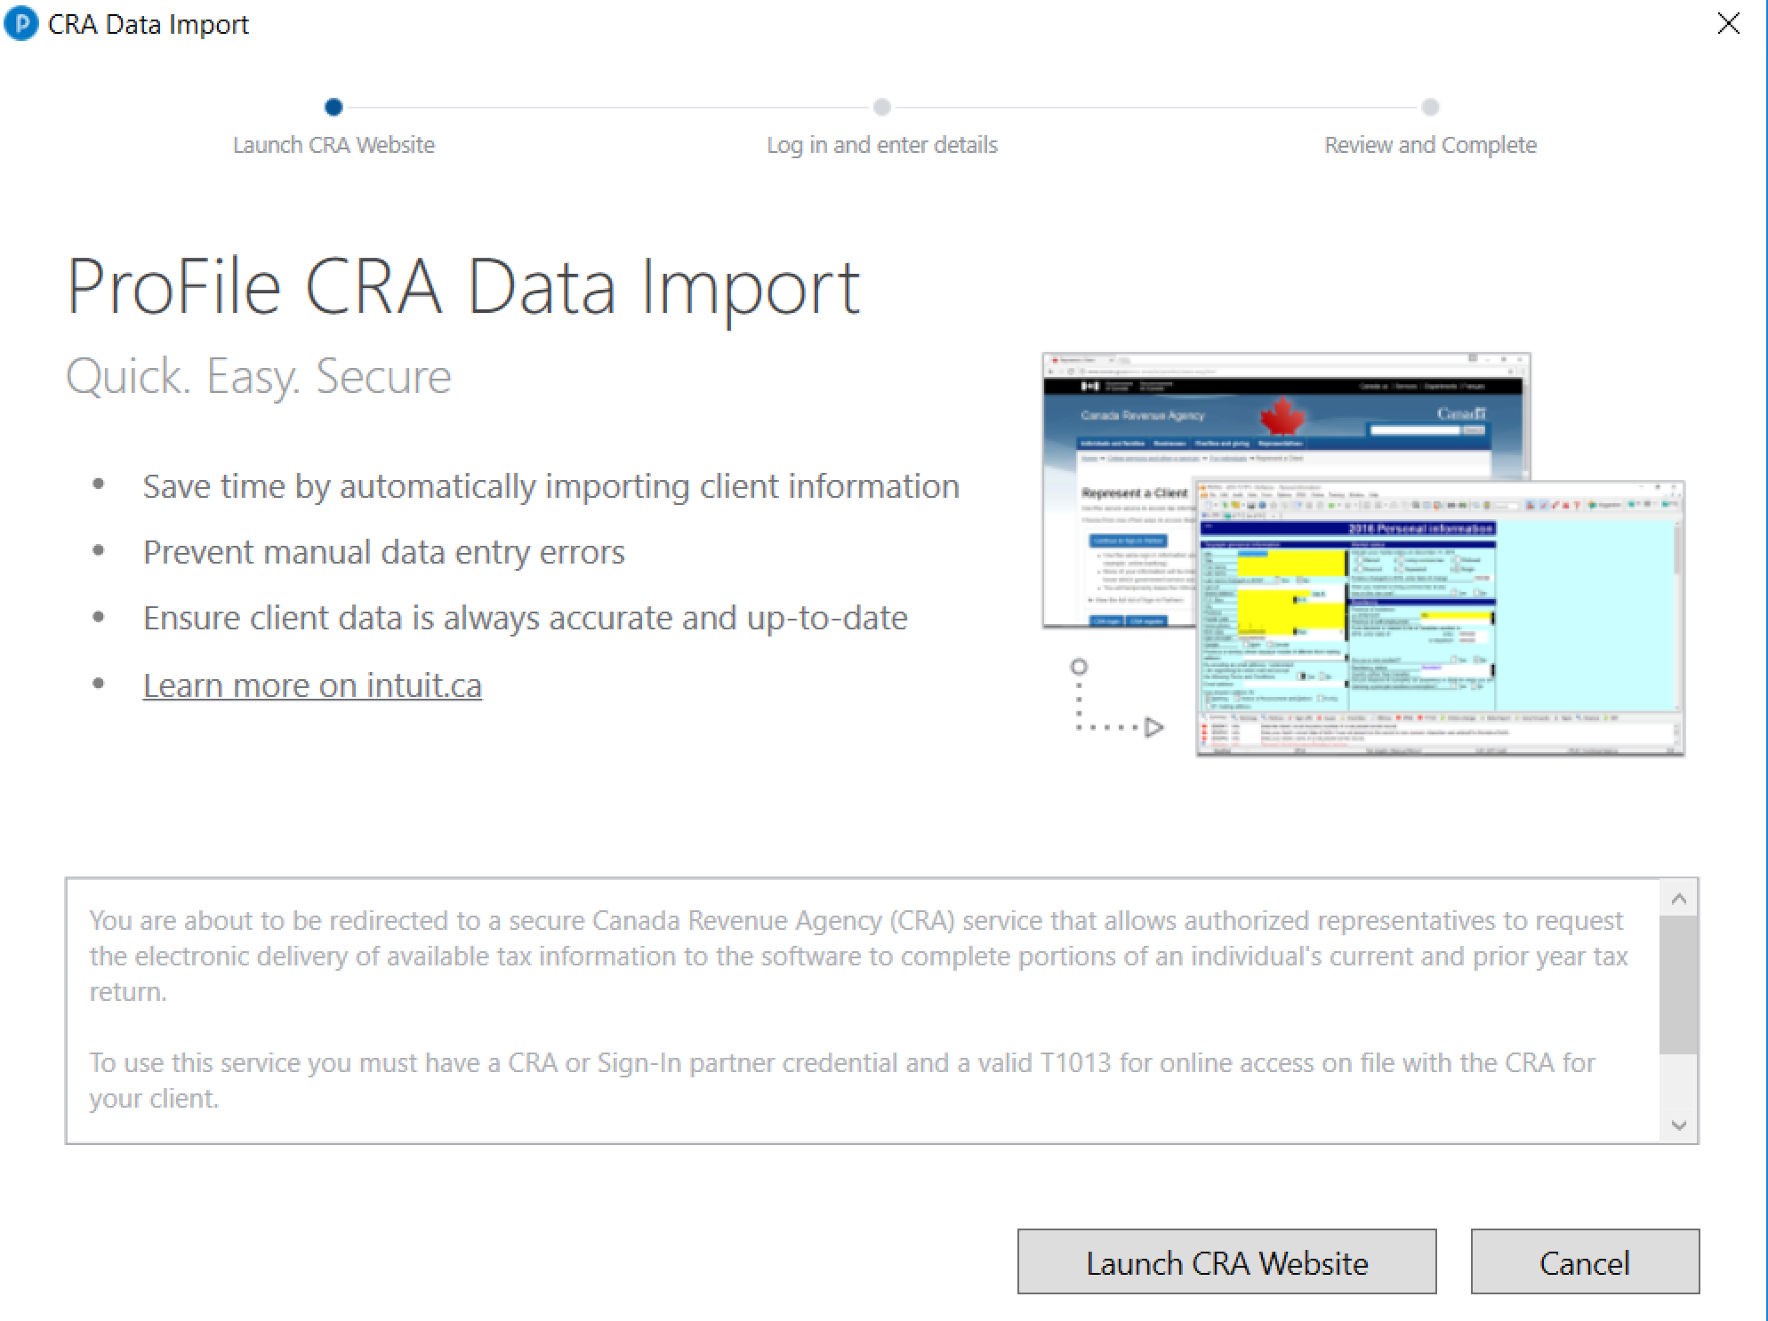
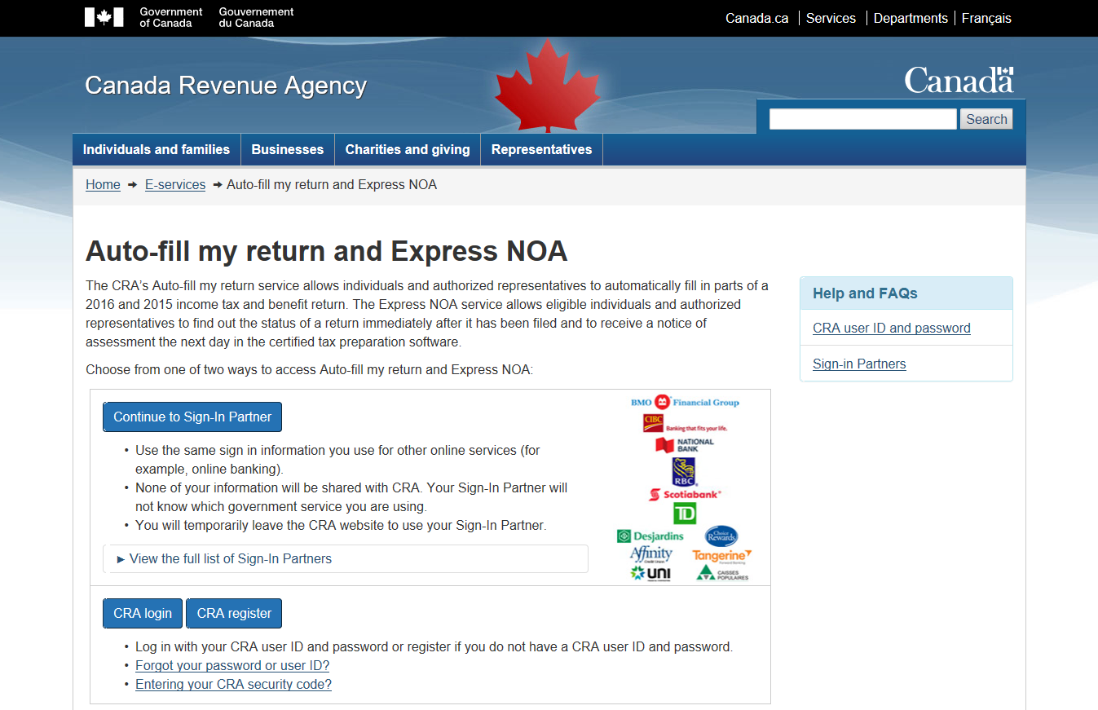
Pages 11-12
autofill my return
Notes:
Mention that these images are duplicated at Pages 11-12

Slide 9
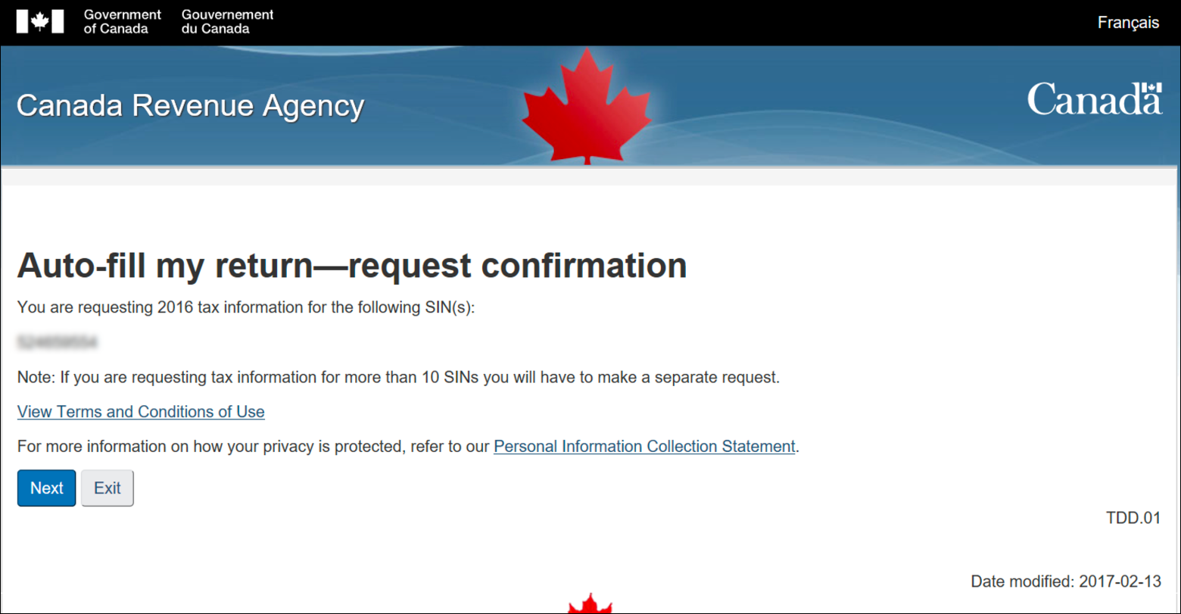
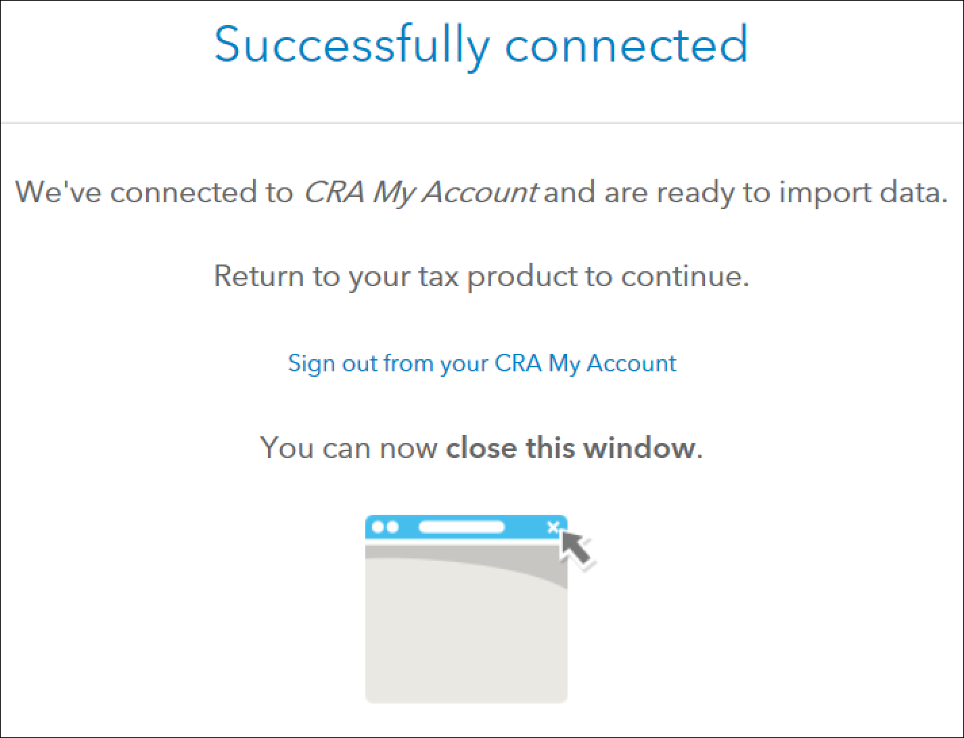

autofill my return
Notes:
Mention that these images are duplicated at Pages 11-12

Slide 10
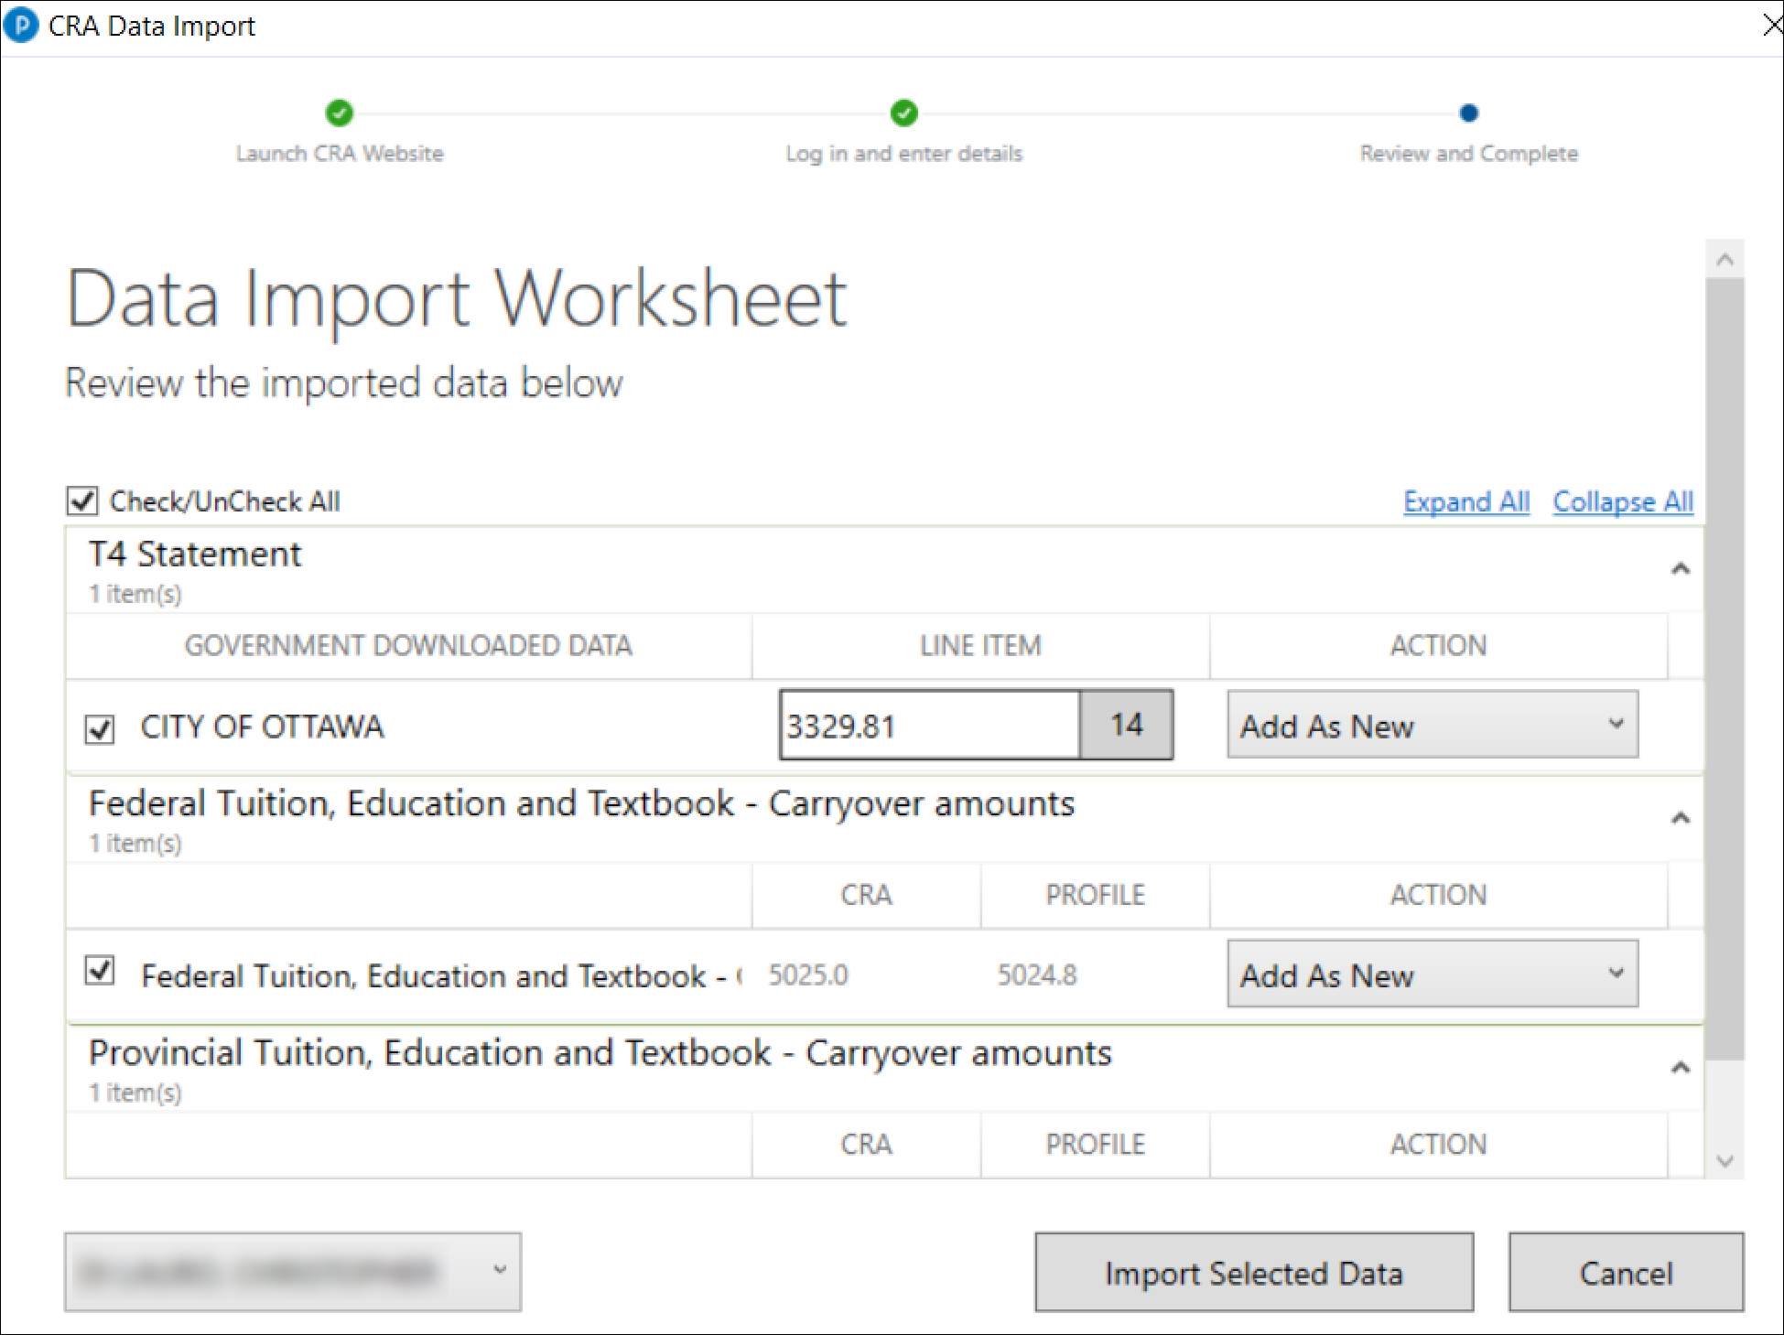
autofill my return
Notes:
Mention that these images are duplicated starting on Page 12

Slide 11
ReFile
Page 12
Notes:
Introduce ReFile at page 12

Slide 12
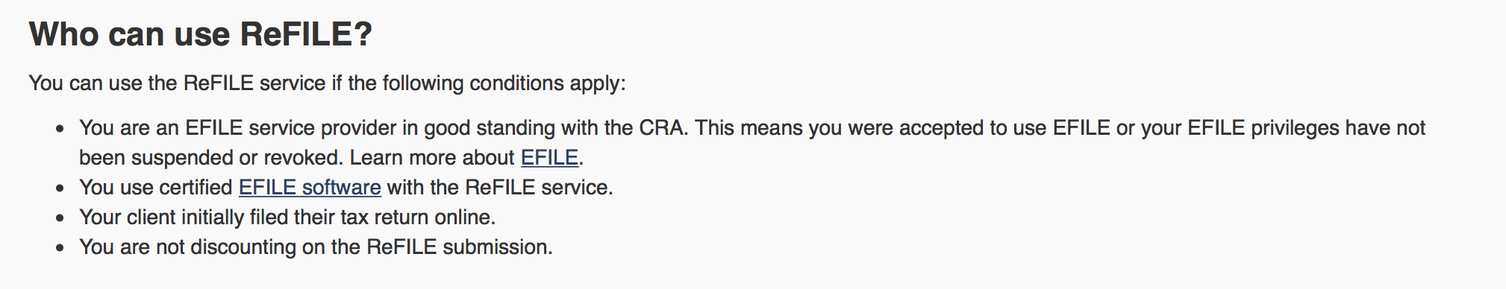
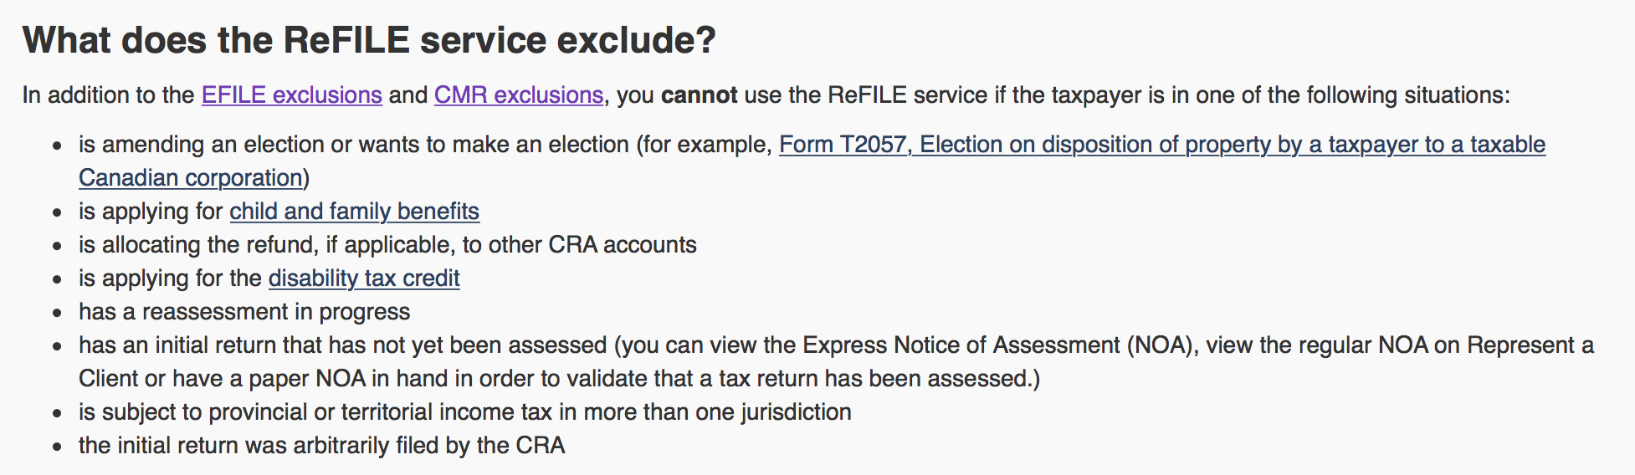
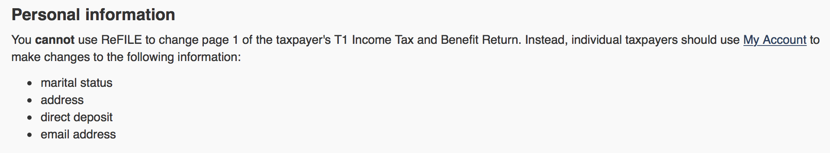
T1 ReFile
What’s excluded?
Limitations
Who can use?
2016 - 2019
Page 13
ReFile
Notes:
xMention that the image on left is discussed at Pp 13
MENTION 2015 AND 2016 ONLY
Discuss the scope, limitations and exclusions, and demo how to ReFile a T1
PER CRA’S WEBSITE
The online system accepts only nine adjustments per tax year for each taxpayer, whether the taxpayer or you or the CRA initiates the adjustments. If you go over the limit, you will get an automated response saying the limit has been reached and explaining how to send a paper request. Make additional requests on paper, preferably using Form T1-ADJ, T1 Adjustment Request, and mail them to the CRA.

Slide 13
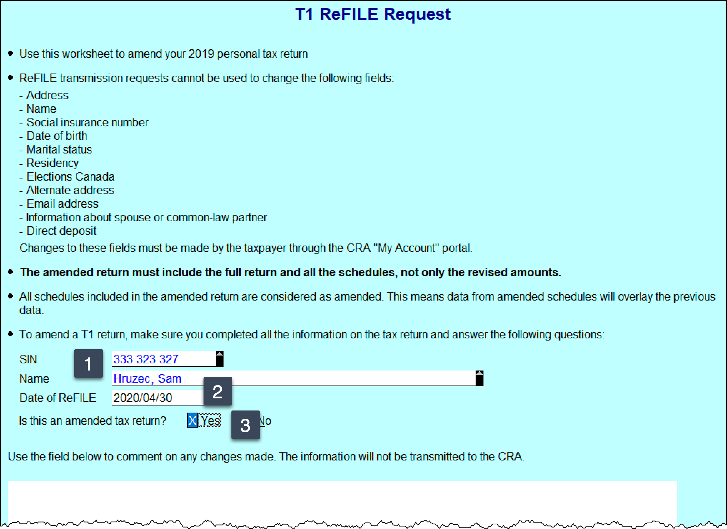
How to
Open T1 > Save as
Amend T1
F4 > T1Refile
Signed T183
Want to Refile like you EFILE?
Info Page > ReFile confirmation
Page 15
ReFile
Notes:
Detailed steps start at Pg15
Open existing return and Save As
Make changes to tax file as required
Open ReFile Form (F4 > T1Refile)
Ensure SIN is indicated
Enter current date in date field
Check the Box to indicate Amended Return
Go through form questions at bottom of Page
Open T183
Notice the R net to the tax year at top right
Check the “Want to REFILE like you EFILE) Box
OBTAIN SIGNATURE ON THE NEW T183
Go to INFO Page and Point to REFILE cofirmation

Slide 14
End

