Slide 1
Learning about Taxes with Intuit ProFile

Slide 2
Chapter 7
Data-mining with Client Explorer

Slide 3
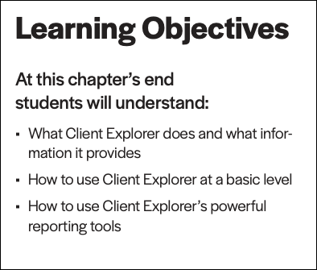

Slide 4
what is Client Explorer?
Notes:
Client Explorer is a database, built into ProFile, that helps you view and manage your clients and their files. With Client Explorer, you can create custom filters that let you open, carryforward and batch EFILE tax returns, and export and print information on your client and their tax files.
The first time you save a new client file, Client Explorer automatically adds a record for that client to the database. And whenever you make a change to a client file, ProFile updates the record for that client.
Client Explorer does not store all of the data found in each individual client file. Instead, it contains references to the file location. However, you can still print reports and export files that include the data from those client files. Also, you must use Client Explorer to print groups of returns or to file groups of returns by EFILE.
It’s important to note that, in addition to Client Explorer, ProFile offers a separate and functionally-different client database called Classic Database. This booklet only covers Client Explorer.
Note: You can use either the Classic Database or Client Explorer — not both.

Slide 5
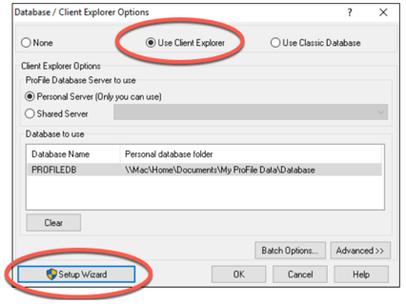
setting up
sole practitioner
shared database
Page 6
client explorer
Notes:
Refer to page 6 and Demo client explorer setup for a sole practitioner
and a shared database P7

Slide 6
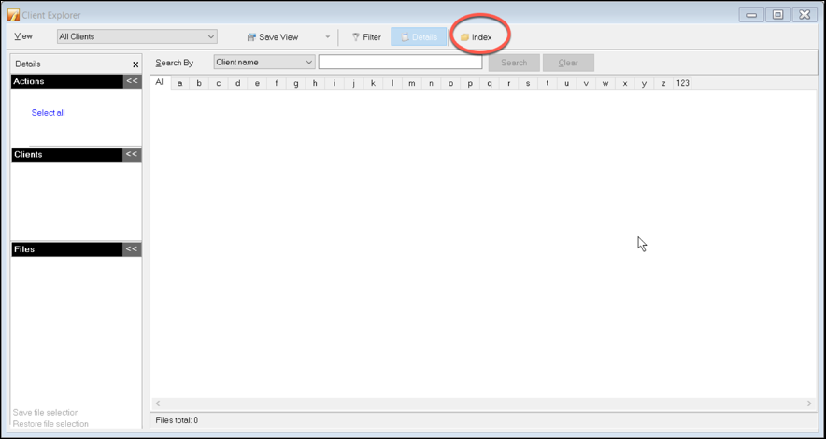
indexing
first-time use only
Pages 8-9
client explorer
Notes:
Refer to pages 8-9 and show how to index files
Mention we only do this the first time we launch Client Explorer

Slide 7
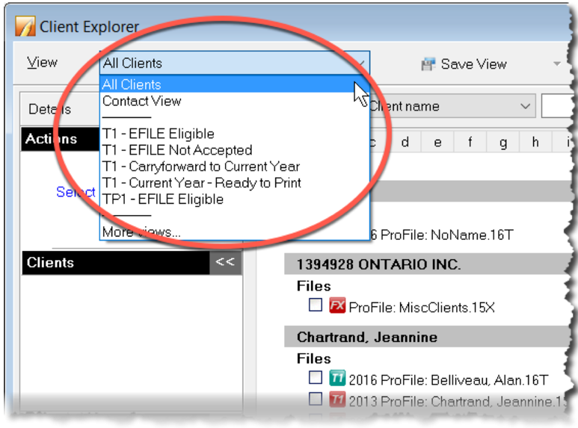
views
filters
customizable
pre-set
contact view
Pages 9-10
client explorer
Notes:
Refer to page 9 and show the pre-set views
Go to page 10 and discuss other views, including Contact
Go to page 10 and discuss the filters

Slide 8
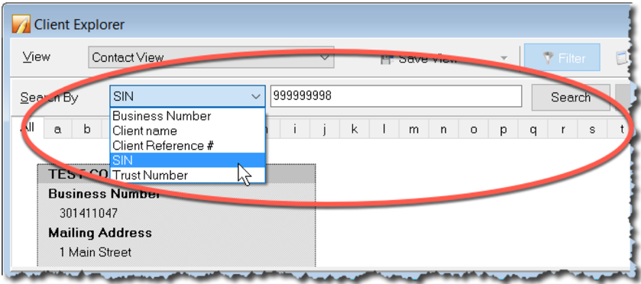
search
find files
right-click
more menus
Page
11-12
client explorer
Notes:
Demo how to use search tool, get client contact info (P11)
Demo right-click files (P12)

Slide 9
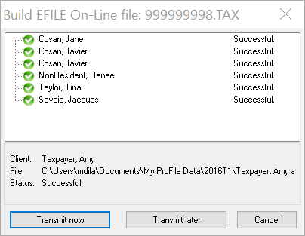
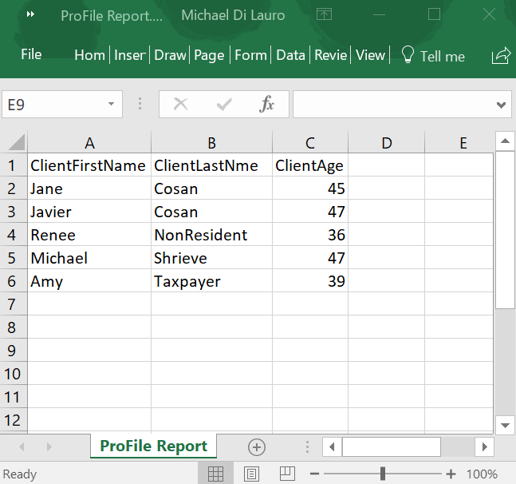
EFILE
Exporting
Page 13
client explorer
Notes:
Show how to EFILE (P13)
In left pane, click Select All
In the View dropdown, select EFILE Eligible
Click checkboxes of files to EFILE
In left pane, choose Build EFILE
Click OK then click Transmit Now
Show how to export reports (P14) WHEN YOU DEMO THIS, MAKE SURE TO NOTE THE FOLDER IN WHICH YOU SAVE YOUR .QEX & .CSV FILES
Select client files and click Database > Export
Click Options in the window that opens
On the Fields tab, click Add and select the fields to add to the report (explain that the Fields tab is used to create the .qex extraction file)
Click the Format tab and then select the Browse icon next to the Export to File field (the Format tab is used to export the actual data to Excel)
Type a file name for the file you’re creating
Click Open
ProFile returns to the Export Options window where you can choose type of file (tab delimited, etc.) and where you can choose options such as exporting field names as header columns in Excel
Go back to the Fields tab, click Save and ProFile will save the .qex file (you may have to enter a filename)
Click Save once more to save the .qex file, and you’ll be taken back to the main/options window
Click OK and you’ll see the Export Files window where you click Export to send the info to the .csv file that you named earlier
Go find the .csv file and open it in Excel.

Slide 10
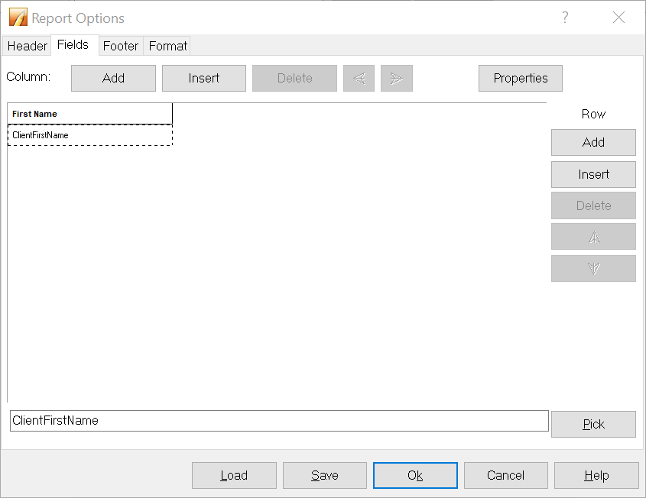
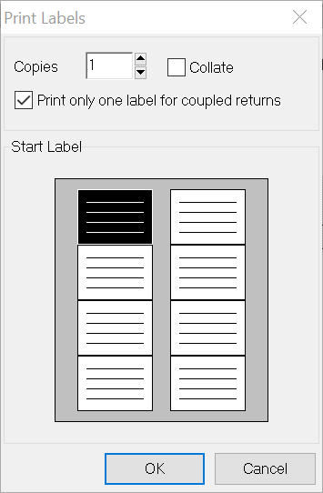
printing reports
labels
Pages 15-25
client explorer
Notes:
Show how to print reports
Steps are similar to Export demo – select files then click Database Print Report
Select Options and on the Header tab, select text that will appear as headers on all the pages (eg: Today)
Go to the Fields tab, select the first (top left) tab and click Properties, in the window that opens enter text for title 1 (you can also choose fonts and other formatting options). Click OK to close the Title Properties dialog box
Double click the cell directly below and choose from a list of field codes and then click OK
Click add to add more cells to the report
You can then click the Footer tab to add footer info
You can also click the Format tab to add other options such as Printer, margins, etc.
Click OK to save your setup options and then click OK to open the Create Report dialog box.
Click Print
Show how to use mailing labels - MENTION THAT ALL FILES HAVE TO BE THE SAME YEAR AND MODULE
File >Setup Mailing Labels
Select module and year and choose the label type
From Client Explorer, choose a few files for a test run and then click Database > Mailing Labels
To avoid printing two labels for each spousal return, check the box marked Print only one label for coupled returns
Review the Mailing Labels dialog settings and click OK

Slide 11
End

