Slide 1
Learning about Taxes with Intuit ProFile

Slide 2
Chapter 8
Advanced Features

Slide 3
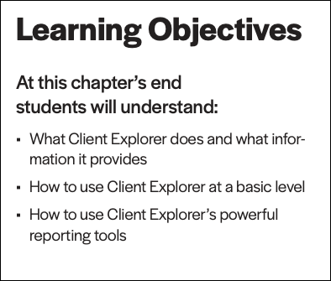

Slide 4
templates
Notes:
Introduce the template discussion on Page 5
If you find that you are constantly checking the same boxes on ProFile’s Info page (for example, the Elections Canada question), or if you find that most of your clients live in the same city or province, you can setup a file template that automatically fills in certain fields with a uniform set of data. This capability is called a file template and, once you’ve set it up, Profile automatically fills in the fields of any new tax as specified in that template.
In addition to pre-filling fields that you specified in the template, you can also set the forms (and the sequence of forms) you want ProFile to open when you first create a new file. You can create a separate file template for each ProFile module.

Slide 5
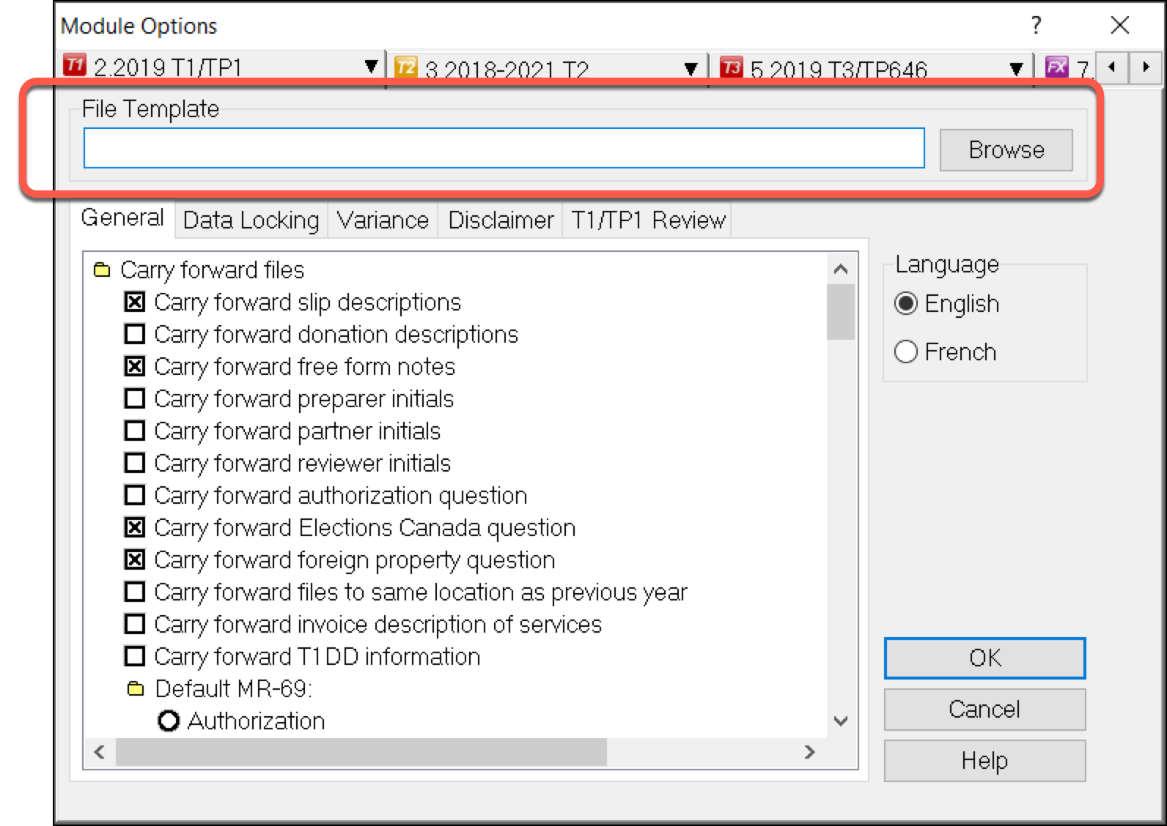
Create new return
Enter default data (Province, Elections Canada, etc.)
Open default forms (T4, T5, etc.)
Save file
Enter file name in Module > Templates
Page 5
file template
Notes:
Detailed steps start at Pg 5
Open existing return and Save As
Make changes to tax file as required
Open ReFile Form (F4 > T1Refile)
Ensure SIN is indicated
Enter current date in date field
Check the Box to indicate Amended Return
Go through form questions at bottom of Page
Open T183
Notice the R net to the tax year at top right
Check the “Want to REFILE like you EFILE) Box
OBTAIN SIGNATURE ON THE NEW T183
Go to INFO Page and Point to REFILE confirmation

Slide 6
HyperDocs
Notes:
Introduce the HypeDocs on Page 7
It may happen that you’d like to attach or link an electronic document to a tax file. You may, for example, want to attach a PDF of a CRA document such as a tax ruling or an interpretation bulletin. Or you may want to link to an image file itemizing details of charitable donations or medical receipts. With ProFile’s HyperDocs, you can do exactly that. In other words, you can attach multiple documents, in any format, to a form or field of a T1 return.
It’s important to note that any HyperDocs document attached to a tax file will be stored for internal purposes only. This means that no HyperDocs attachment will ever get transmitted to CRA.

Slide 7
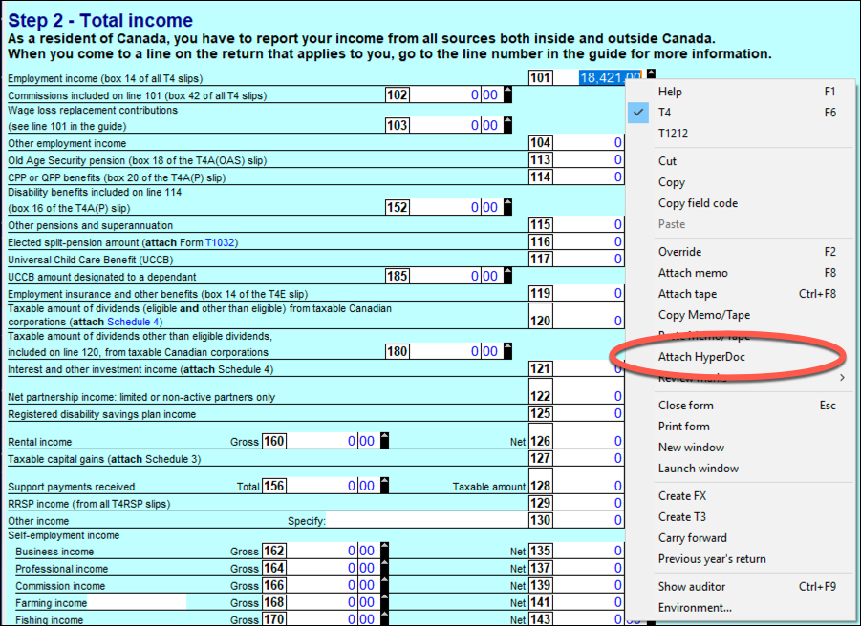
a convenient way to attach source documents to a tax file
Page 7
hyperdocs
Notes:
Refer to Page 7 and describe what is HyperDocs and how you attach documents
Use HyperDocs to attach a document to a line of the return or to the return as a whole.
Discuss the difference between Embed and Link (Page 8)

Slide 8
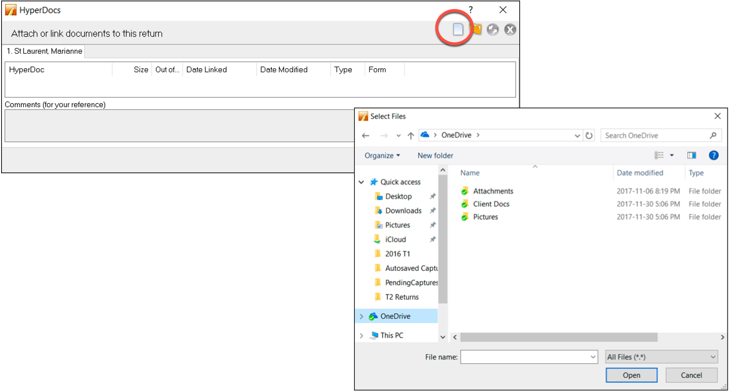
HyperDocs management
Removing documents
Synchronizing
Page 8
hyperdocs
Notes:
Refer to Page 8 and discuss HyperDocs management
Whether you add a HyperDocs to the tax file in general or to a specific area of the tax file, you will find all attached documents in the HyperDocs window. To view all attached documents:
Go to File > HyperDocs
All attached documents appear in the HyperDocs window along with any comments that you entered. The HyperDocs window also lists key information that includes:
The date the document was attached and/or modified
The process you chose to attach the file (linked or embedded)
And the form to which the document was attached
Also discuss how to remove documents page 9
And discuss Synchronization at Page 10

Slide 9
snapshot and variance
Notes:
Refer to Page 10 and discuss Variance & Snapshot
Variance is a feature that you use to highlight significant changes on a tax return. Variance lets you experiment with different scenarios and quickly identify the impact of a change on many key fields. Variance is only calculated for fields with CRA line numbers. So, not all fields (for example on worksheets) will be included in the variance comparison. You activate the variance feature by taking a snapshot of the tax return.

Slide 10
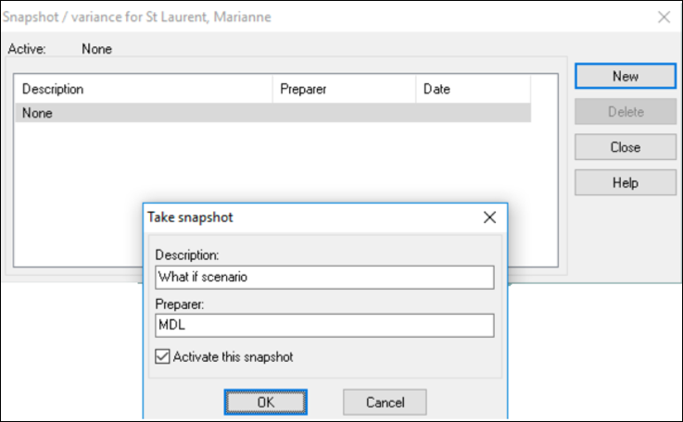
snapshot
prior-year variance
Page 10-13
variance
Notes:
Refer to page 10 and discuss…
To take a snapshot of your current return
From the Audit menu, select Snapshot/variance and click the New button. This will take a picture of the current contents of the tax return
Give the snapshot a name that will remind you of the purpose of the scenario
Select the Activate this snapshot option to have ProFile compare any changes you make in the file to this snapshot and click OK
Also discuss the Variance tab on the Active Auditor – Page 11
And discuss the prior-year variance at Page 12
Finally mention the Variance Threshold setting at Page 15

Slide 11
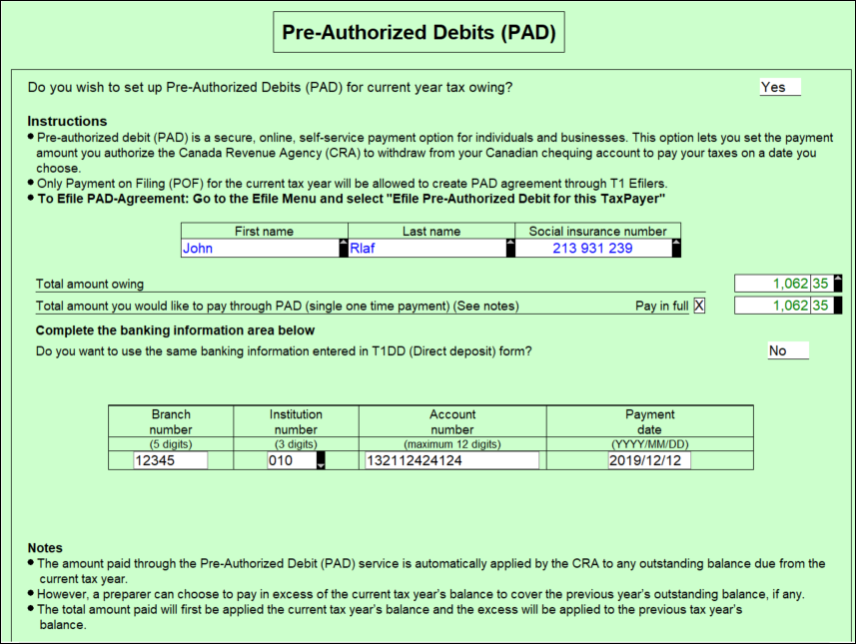
F4 > T1Pad
Select > Yes
Click Pay in Full
Go to EFILE > EFILE PreAuthorized Debit
Page 13
t1 pad
Notes:
Demo T1PAD – P 13
Pre-authorized debit (PAD) is a secure, online, self-service payment option for individuals and businesses. This option lets you set the payment amount you authorize CRA to withdraw from a Canadian chequing account to pay taxes on a date, or multiple dates.
Due to the processes that must take place between the CRA and the financial institution, the selected payment date must be at least five business-days from the date your PAD agreement is created or managed.

Slide 12
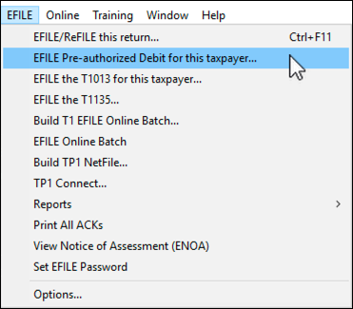
Express Notice of Assessment
Page 14
Express NoA
Notes:
Express Notice of Assessment starts on page14
Express Notice of Assessment (NOA) is a CRA service that allows you to view the basic result of an assessment immediately after filing a return and to receive the full notice of assessment the next day.
This instant assessment provides the status of your client’s return with a summary of the refund, amount owing, or a zero balance and deposit information, if applicable.
The full notice of assessment provides an account summary with the result of the assessed return showing a refund, a zero balance, or a balance owing, tax assessment summary, explanation of changes and other information, and RRSP/PRPP deduction limit statement. It may also contain the Home Buyers' Plan statement and Lifelong Learning Plan statement.

Slide 13
End

