Slide 1
Learning QuickBooks Online
Instructor: Your name here
Notes:
Our PowerPoint template is not compatible with versions of Microsoft Office older than Mac MS Office 2016 and PC MS Office 2013. You may experience some bugs if you’re using an older version.

Slide 2
Lesson 1
New Company Setup

Slide 3
Lesson 1 – Learning Objectives
Subscribe to QuickBooks as a student
http://education.intuit.ca/education-program/students.jsp
In this lesson you’ll learn:
How to Setup a QuickBooks Company File
Import Lists
Enable Sales Tax
Setup Users

Slide 4
QuickBooks File Setup Demo
Notes:
Demonstrate Lesson 1. The students should not do this with you. Follow the instructions in Lesson 1 of the lesson guides.
Main topics should cover:
Setting up student file if not already covered
Setting up basic company
Setup account and settings
Explain How QuickBooks is Built (is in next Lesson)
Setup users

Slide 5
Lesson 2
Getting Around QuickBooks Online

Slide 6
Lesson 2 - Learning Objectives
In this Lesson you’ll learn the following:
How QuickBooks is Built
Sign-in to QuickBooks
QuickBooks Dashboard
3 Ways to Navigate
Transaction Entry

Slide 7
Getting Started in QuickBooks
It’s recommended that you use the Google Chrome browser:
Chrome can be used on both Mac and Windows platforms
Open QuickBooks in multiple tabs for easy navigation
Intuit develops QuickBooks for use with Chrome
Chrome is the the most widely used browser
Note: You can use Mozilla Firefox. Internet Explorer and Safari are not fully supported (they can still be used but not all features are fully supported)

Slide 8

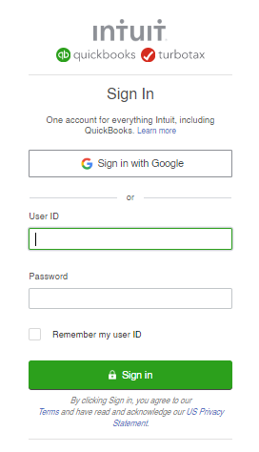
Sign-In to QuickBooks
To login to QuickBooks you’ll go to the following website:
ca.qbo.intuit.com
Tip: Bookmark this page in your browser for easy access to the QuickBooks sign-in page

Slide 9
Your Turn #1… Lesson 2
1
Go to tinyurl.com/canadasampledata
    Sample company used for in-class work, examples and testing
2
Enter Code to enter company or select… “I’m not a Robot”
Notes:
Depending on the browser you use in your environment you may need to edit the content settings to allow this site. This is dependent on your individual situation.

Slide 10
Your Turn #2…Lesson 2
You want to run a General Ledger report. Find and run the report.
01
04
05
03
You need to add an account to the chart of accounts. Open the Chart of Accounts...no need to add the account at this time.
You want track a budget for the upcoming year. Find the appropriate link to start the process.
02
You want to create an Estimate for a customer. Find the Estimate transaction.
Time to pay bills. Open the window to Pay Bills.
Notes:
Have the students try these 10 exercises as an exercise in ”jumping in the deep end”. The ways of getting around will be discussed in the next few slides following the your turn activity.

Slide 11
Your Turn #3…Lesson 2
You want to open a second window in QuickBooks. Open the Reports centre in a second tab.
01
03
You need a list of invoices. Locate the Invoices list.
05
You need to enable a setting to avoid duplicate bill numbers. Find the setting to enable this feature.
You ask your friend to help you with QuickBooks. Find where to add them as a QuickBooks user.
You’re looking for Invoice #1009. Locate the Search feature and find the invoice.
04
02
Notes:
TIP: #2 Right click on any window and click “Open link in new tab” This feature is available in Google Chrome.

Slide 12
Dashboard
Displays the following:
Basic Profit and Loss information
Recent income and expenses
Banking information (right-side)
01
02
03
Note: Select Privacy to hide financial information on the Dashboard
Notes:
Highlight the various areas of the Dashboard with each bullet.
Click the Privacy button to turn off all numbers displayed on the Dashboard.

Slide 13
3 Ways to Get Around
01
02
03
+New Menu
Navigation Bar
Gear Icon
    Everyday transactions entry
    All transactions are listed in this menu
    Find transactions by name
    Find transactions by transaction type
    Important lists and actions not used as frequently as other menus
Notes:
Review how to use:
Create menu – day to day transactions in QB. Go here to enter every possible transaction in QuickBooks
Navigation bar – go here to find transactions related to the people or businesses you’re doing business with
Gear Icon (Company Menu) – important list of tasks, functions and lists, but not used as frequently as the Create menu.

Slide 14
QuickBooks Online Navigation Demo
Notes:
Review how to use:
Create menu – day to day transactions in QuickBooks. Go here to enter every possible transaction in QuickBooks
Navigation bar – go here to find transactions related to the people or businesses you’re doing business with
Gear Icon (Company Menu) – important list of tasks, functions and lists, but not used as frequently as the Create menu.

Slide 15
Your Turn #4…Lesson 2
01
02
03
Lists
Transaction Forms
Other Functions
    Add list information to QuickBooks
    Includes Chart of Accounts, Customers, Suppliers, etc.
    Complete forms to make accounting entries
    QuickBooks completes the debits and credits behind the scenes
    Reporting, Reconcile, Budgets are examples of other functions available
Notes:
Lists –
foundation of QuickBooks.
Enter lists once and not enter them again
Makes entering form information much easier.
You can import lists at the start of your company, enter individual list entries at one time or usually add them on the fly
Transaction Forms –
Fill out forms using lists.
They include both sales and expenses like invoices, sales receipts, bills, cheques, etc.
Similar look and feel so they’re easy to use
Other Functions –
Actions like reconcile
Budgeting
Reports
Other items that are important in accounting but do not include making accounting entries on forms

Slide 16
How QuickBooks is Built - Workflow
Lists
Transaction forms
Other Functions
    Lists include:
    Chart of Accounts
    Customers
    Suppliers
    Products and Services
    Transactions include:
    Invoices
    Bills
    Cheques
    Sales Receipts
    Journal Entries
    Functions include:
    Reconcile accounts
    Files Sales tax
    Budgets
    Job Costing
Transaction forms
Notes:
Flow chart builds to show the traditional workflow of QuickBooks work

Slide 17
Transaction Forms Overview
    Who
    Choose the name of the person or business you’re doing business with like customers, suppliers, and others
    Where
    Date of the transaction
    Service date is another date field
    What
    What you’re selling or the expense you’re incurring
    How Much
    Amount and may also includes amount of sales tax
Notes:
Highlight the primary areas of the form
Who – include the name of the customer or supplier
When – transaction date
What – typically means choosing what you’re selling to a customer or choosing what you’re purchasing from a supplier in the form of an account
How much – includes the amount of the sale or purchase plus the additional sales tax that might be added to transactions

Slide 18
Adding List
Items Demo

Slide 19
Your Turn #5…Lesson 2
    Coworkers keep visiting your desk and you don’t want to share the company information? Turn on Privacy mode.
01
02
    You want to open the Reports page in a separate tab. Open the new tab.
    You’d like a quick view of how last month went. Find the Company Snapshot for your business.
03
    You need to see a list of sales invoices. Find a list of invoices.
04
Notes:
#2 can be completed by right clicking in Google Chrome and choosing ”Open link in new tab”
#3 can be found on the Customer centre in the Invoices tab (from top of window)
#4 Go to Reports and click Recommended and then choose Company Snapshot

Slide 20
Lesson 3
Sales & Customers Part 1

Slide 21
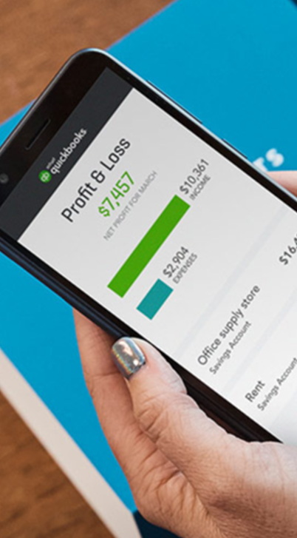
Lesson 3 - Learning Objectives
In this Lesson you’ll learn the following:
    Adding customers
    Adding Products and Services
    Sales workflows
    “Cash Sales” – when customers pay at the time of sale
    Accounts Receivable – when customers pay later

Slide 22
Add Customer Demo
Notes:
Highlight how to add a customer. Review the fields in detail.

Slide 23
Your Turn #1…Lesson 3
1
    Add a new customer named Wonderful Weddings by Wanda
    Owner’s name is Wanda Williams
    Address is - 400 Willowview Dr. Toronto, ON. M6H 3K9
    They prefer to pay by Cheque
    Their invoices are due within 30 days
2
    Add a new customer named Excellent Events
    Address is - 36 Bay St. Toronto, ON. M6H 3K5
    They prefer to pay by Credit Card
    Their invoices are due within 30 days
    They want their invoices “Sent later”

Slide 24
Your Turn #2…Lesson 3
1
    Add a new customer named Chuck Jones
    Address is – 67 Willowgate Close Toronto, ON. M6K 2K1
    They prefer to pay by Cheque
    Their invoices are due within 30 days
2
    Add a new customer named Foody Food Company
    Address is – 58 Eglinton Toronto, ON. M6H 3K9
    They prefer to pay by Cheque
    Their invoices are due within 30 days
    They want their invoices “Sent later”

Slide 25
Purpose of Products & Services List
01
02
03
04
    Makes it easy for you to fill out forms when you add a detailed list of each product or service you sell to customers.
    Link to accounts in QuickBooks Online. Creates the journal entry based on the form type and the accounts linked to the items on the form. Assists with the “behind the scenes” accounting.
    Helps make reporting on products and services easy.
    Allows you to track quantities purchased and sold when you use inventory (Inventory businesses)
Notes:
Review each point in detail to provide context for the products and services list:
Makes it easy to complete forms
Does the “behind the scenes accounting”
Help create the preset reports without having to do any manual work.
Inventory numbers can be tracked with detailed product setup

Slide 26
Product & Service Types
01
02
03
04
    Service
    Non-Inventory Part
    Inventory Part
    Bundles
    services you provide to customers. e.g. consulting
    supplies or materials used in providing your services (e.g. food in the catering company).
    inventory parts bought, tracked and sold. Keep track of inventory parts on hand.
    a group or products and service.
Notes:
Review each item in the new product/service window. Explain in detail what a service is and non-inventory part.(pages 6-7)

Slide 27
Add Products & Services List Demo

Slide 28
Your Turn #3…Lesson 3
1
    Add a new service called Professional DJ Services
    It tracks to the account called Sales on the Profit & Loss Report
    It has a fixed price of $3000.00 and is taxable (H)
    The Description on the sales invoice should read:
    “Professional DJ Services provided by C & C Music Factory”
2
    Add a new service called Valet Parking Service
    It tracks to the account called Sales on the Profit & Loss Report
    The price of the service varies by customer sale but is taxable (H)
    The Description on the sales invoice will be unique on every sale

Slide 29
Your Turn #4…Lesson 3
1
    Add a new service called Food Preparation
    It tracks to the account called Sales on the Profit & Loss Report
    There is no fixed price but it is taxable (H)
    The Description on the sales invoice will be entered as needed on customer invoices
2
    Add a new service called Event Setup
    It tracks to the account called Sales on the Profit & Loss Report
    The price of the service varies by customer sale but is taxable (H)
    The Description on the sales invoice will read “Event Setup”

Slide 30
Money-in Workflows
    Sales Receipt
    Make Deposit
    Customer pays
    at time of sale
    Invoice
    Receive Payment
    Bank Deposit
    Customer has
    XX days to pay
Notes:
Slides build for each workflow
Explain two workflows for
Sales Receipt → Make Deposit (Cash sales)
Invoice→ Receive Payment → Bank Deposit

Slide 31
Sales Receipt Workflow Demo
Notes:
Demonstrate creation of sales receipt followed by the deposit.

Slide 32
Money-in Workflows
    Sales Receipt
    Make Deposit
    Customer pays
    at time of sale
Notes:
Slides build for each workflow
Explain two workflows for
Sales Receipt → Make Deposit (Cash sales)
Invoice→ Receive Payment → Bank Deposit

Slide 33
Undeposited Funds in QuickBooks Online
    Purpose of Undeposited Funds:
    Hold funds until the deposit is made
    Helps with bank reconciliation to ensure that grouped payments in QuickBooks match deposits from the Bank Statement
    Undeposited Funds
    Bank Deposit
    Sales Receipt
    Bank Deposit
Notes:
Explain that you can deposit directly to the Bank but it’s more likely to go to undeposited funds and then to Bank Deposit. The undeposited funds account often mimics what small businesses do between receiving funds and the time that they go to the bank to make the deposit.
The undeposited funds most importantly is used to match the deposits in QB to the deposits made at the bank. It’s a best practice to put everything through undeposited funds.

Slide 34
Your Turn #5…Lesson 3
1
    Create a Sales Receipt for Wonderful Weddings by Wanda
    They purchased Professional DJ Services
    The price was $6500 + HST
    They paid with Cheque #5733 (Not deposited until next bank run)
2
    Create a Sales Receipt for Excellent Events
    They purchased Valet Parking Service
    The price was $2305 + HST
    The Description should read “Valet parking at Charity Event”
    They paid with Cheque #839033 (Not deposited until next bank run)

Slide 35
Your Turn #5…Lesson 3
1
    Create a Sales Receipt for Chuck Jones
    They purchased Professional DJ Services
    The price was $8500 + HST
    They paid with a Credit Card (Deposit directly to the bank)
2
    Create a Sales Receipt for Foody Food Company
    They purchased Catering
    The price was $4300 + HST
    The Description should read “Catering for charity event”
    They paid with Cheque #9453 (Not deposited until next bank run)

Slide 36
Invoice - Accounts Receivable - Workflow Demo

Slide 37
Money-in Workflows
    Invoice
    Receive Payment
    Bank Deposit
    Customer has
    XX days to pay
Notes:
Slides build for each workflow
Explain two workflows for
Sales Receipt → Make Deposit (Cash sales)
Invoice→ Receive Payment → Bank Deposit

Slide 38
Your Turn #6…Lesson 3
1
    Create the following invoices:
    Create an Invoice for Alba Fay
    She purchased Catering for $7,763 + HST
    The Description is “Football Grey Cup Party for 150 attendees”
2
    Create an Invoice for Adwin Ko
    He purchased Food Preparation for $9,000 + HST
    The Description is ”Food Prep”

Slide 39
Your Turn #7…Lesson 3
1
    Add a new customer named Steve Young
    Owner’s name is Steve Young
    Address is – 1000 Queen St W, Toronto, ON. M8Z 3K9
2
    Create the following transaction:
    Create an Invoice dated Sept. 1, 2017
    They bought Catering for $9,488 + HST
    The Description is “Football kickoff Party for 300 attendees”
3
    Receive the Payment from Steve Young today.
    Paid with Cheque #109. Cheque is not deposited yet.

Slide 40
Your Turn #8…Lesson 3
1
    Make a Deposit of the following cheques:
    Date: Friday of this week
    Deposit Cheques: #5733, #839033 and #109.
2
    Receive the Payment from Steve Young today.
    Paid with Cheque #109. Cheque is not deposited yet.

Slide 41
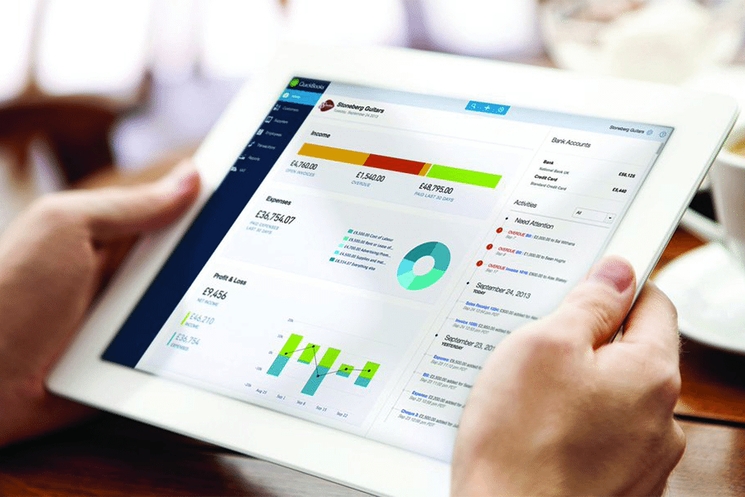
Your Turn #9…Lesson 3
1
    Create a Sales by Customer Detail report
2
    Create an A/R Aging Summary report
Notes:
Demonstrate these two important sales and accounts receivable reports

Slide 42
Lesson 4
Suppliers & Expenses Part 1

Slide 43
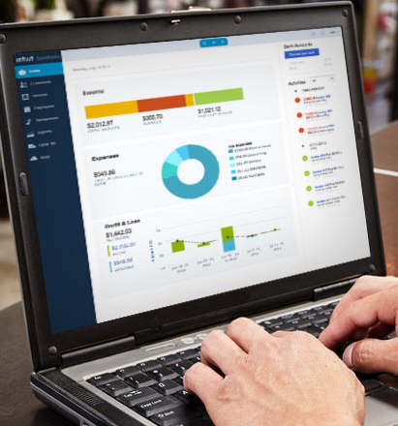
Lesson 4 - Learning Objectives
In this Lesson you’ll learn the following:
    Adding suppliers
    Accounts Payable workflow
    Bills → Pay Bills
    Expenses workflow
    Expenses
    Cheques

Slide 44
Expense Workflows in QuickBooks Online
“Cash” Transactions
Accounts Payable
Expense
Cheque
Enter Bills
    Expense includes:
    Debit
    Interac
    Direct withdrawal
    Wire Transfers
    Credit Card Charges
    PayPal
    Other…
Print Cheques
Pay Bills
Notes:
Explain overall expense workflows for
Expense transactions including expense and cheque
Explain the workflow for accounts payable Enter Bills → Pay Bills. Explain that it’s very important not to mix the workflows. i.e. do not Pay a Bill with a cheque. The Workflow should always be Enter Bill followed by Pay Bills.

Slide 45
Add Suppliers Demo
Notes:
Add a couple suppliers for the students highlighting the important fields in the setup.

Slide 46
Your Turn #1…Lesson 4
01
02
03
    Create the supplier:
    Name: Vinnie’s Valet Service
    Address: 300 Main St. Mississauga, ON. L5J 8K9
    Create the supplier:
    Name: Cakes by Katy
    Address: 588 Gateway Lane Toronto ON. M5J 8K5
    Create the supplier:
    Name: Super Servers
    Address: 677 Muskoka Way Barrie, ON. L4M 2W8

Slide 47
Your Turn #2…Lesson 4
1
    Create the following Suppliers:
Community Credit Union
The Power Company
Staples
Canada Post
Intuit
***No Contact Information is required for these Suppliers.
Notes:
If you use expenses for cheques and expenses and not on bills, the student can add suppliers with no contact information. This is how you handle any chains like Staples, Canada Post, etc.

Slide 48
Expense Workflows in QuickBooks Online
“Cash” Transactions
Expense
Cheque
    Expense includes:
    Debit
    Interac
    Direct withdrawal
    Wire Transfers
    Credit Card Charges
    PayPal
    Other…
Print Cheques (optional)
Notes:
Explain overall expense workflows for
Expense transactions including expense and cheque
Explain the workflow for accounts payable Enter Bills → Pay Bills. Explain that it’s very important not to mix the workflows. i.e. do not Pay a Bill with a cheque. The Workflow should always be Enter Bill followed by Pay Bills.

Slide 49
Expense Demo
Notes:
Demonstrate the example of creating expenses from scratch. This means both bank and credit card transactions.

Slide 50
Your Turn #3…Lesson 4
    You made the following purchases on the 10th of this month. Record them in QBO.
1
2
3
4
Office Supplies from Staples for $86.65 including HST.
Equipment Rental from Garcia’s Event Space for $1209 + HST on the Visa Credit Card.
Bank Charges from Community Credit Union for $15.00 in the Chequing account (not taxable)
Accounting Services provided by Michelle Long for $547.60 + HST. Track to Professional fees.

Slide 51
Accounts Payable Workflow in QuickBooks Online
Accounts Payable
Enter Bills
Pay Bills
Print Cheques (optional)
Notes:
Explain that when the students want to manage and track bills to be paid later, they will Enter Bills followed by Pay Bills. The pay bills will provide the option to create and print a cheque if required.

Slide 52
Bills → Pay Bills Demo (Accounts Payable)
Notes:
Demonstrate the example of creating expenses from scratch. This means both bank and credit card transactions.

Slide 53
Your Turn #3…Lesson 4
    You receive a few bills on the last day of last month. Enter the following bills:
1
    City Water Company for $296 + HST. You choose the account.
2
    Vinnie’s Valet Service for $5871 + HST for Subcontracting. The description should read “Valet parking for wedding event at Community Church”.
3
    Gibson Printing (Kristina Gibson) for printing services. Amount is $348.50 including HST.

Slide 54
Your Turn #4…Lesson 4
    You receive a few bills on the last day of last month. Enter the following bills:
1
    Cakes by Katy for $1876 + HST. You choose the account.
2
    Super Servers for $4619 + HST for Subcontracting. The description should read “Service at the Looney-Warde wedding”.

Slide 55
Your Turn #5…Lesson 4
    You do a “Cheque Run”. Pay the following bills on the 15th of this month:
1
    City Water Company by cheque from the Chequing Account.
2
    Vinnie’s Valet Service by cheque from the Chequing Account.
3
    Gibson Printing bill was partially paid ($200) by cheque from the Chequing Account.
4
    Pay the Cakes by Katy bill by credit card in full from the Visa account.

Slide 56
Cheques in QuickBooks Demo

Slide 57

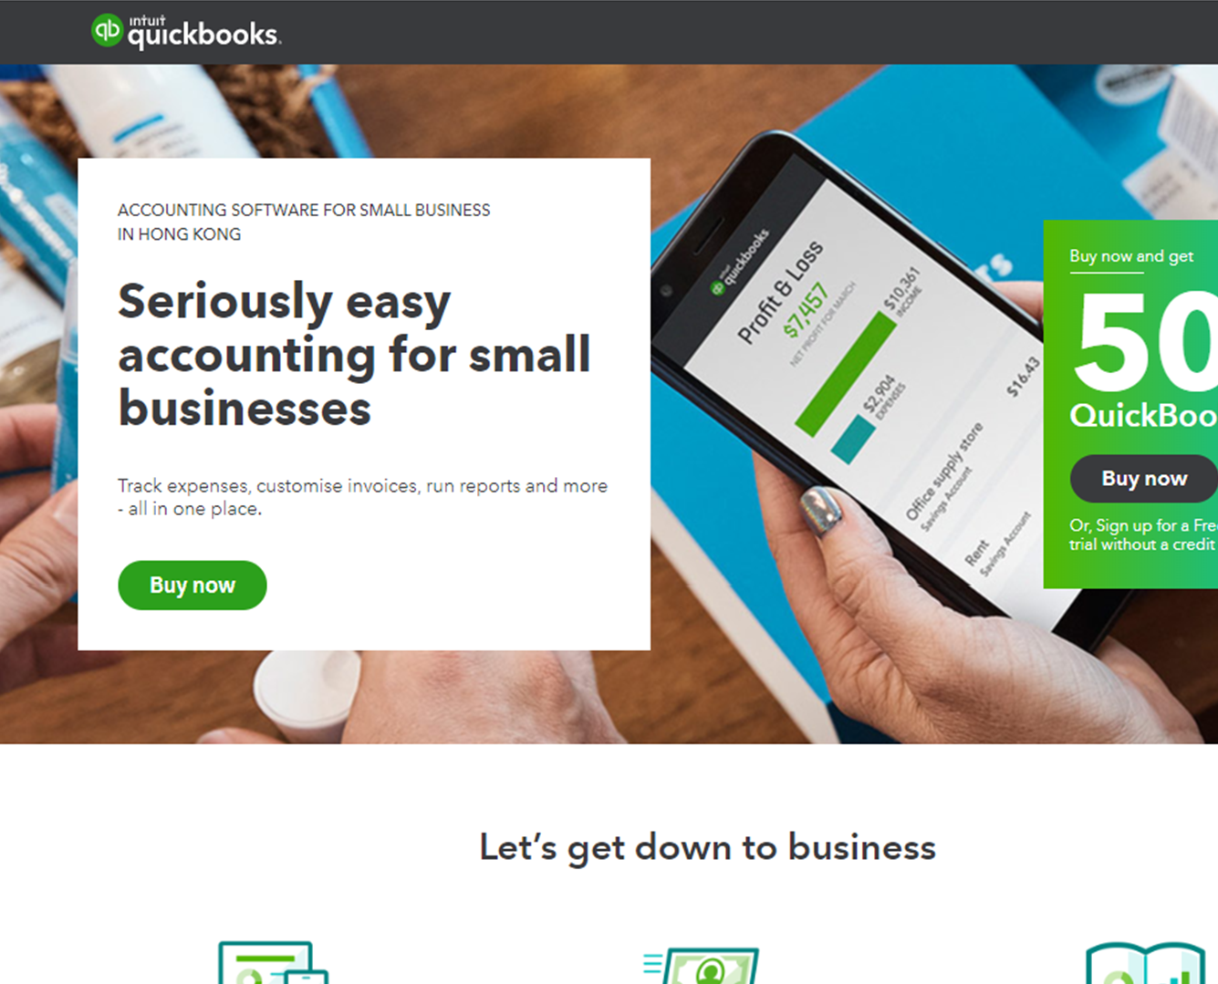
Your Turn #6…Lesson 4
You write a cheque today for personal assistant services for $12,000 + HST for the year. You write the cheque to Gina’s Virtual Assistant Services (Gina Han).
Note: use the next cheque number in sequence.

Slide 58
Lesson 5
Company Activities Part 1

Slide 59
Lesson 5 - Learning Objectives
In this Lesson you’ll learn the following:
Editing, Deleting and Merging list items
Other lists in QuickBooks
Working with the Chart of Accounts

Slide 60
Lesson 5 – Other Lists in QuickBooks
Other lists include:
    Recurring transactions - list of scheduled or saved transactions
    Product Categories – a way of classifying products on the products and services
    Custom Form Styles – templates for sales forms
    Currencies – currency list when buying or selling in foreign currencies
    Payment methods – methods for customers to pay your company
    Terms – terms to be provided to customers or from suppliers
    Attachments – a list of stored attachments from transactions or records on names

Slide 61
Your Turn #1…Lesson 5
1
Find the Currency List.
2
Find the Terms list.
3
Find the Categories list and try to add a new category.
4
You want to find an Attachments in QuickBooks. Find the list.
5
You want to automate a transaction. Which list would you add the transaction to and where is it?
Notes:
All lists are available under the GEAR icon.
#5 is Recurring Transactions

Slide 62
Other List Review
Notes:
Highlight the other lists in Gear icon.

Slide 63
Chart of Accounts
Notes:
Highlight the other lists in Gear icon.

Slide 64
Chart of Accounts Overview
01
02
03
    Details and balances of all accounts available in QuickBooks
    Chart of Accounts displays Balance Sheet accounts on the top of the list and Income Statement accounts at the bottom of the list.
    Edit the display of the Chart of Accounts when you click the Gear icon on the list.
Notes:
Review the basic features of the Chart of Accounts.

Slide 65
Account Types in QuickBooks
Balance Sheet Accounts
Bank Account – add one bank account for every account in the company
Accounts Receivable – tracking outstanding accounts receivable including invoices, credits and payments on customer accounts
Current Asset – Assets that are likely to be converted to cash or used up within on year
Fixed Asset – Depreciable assets your company owns
Other Asset – any assets not considered Current or Fixed asset
Accounts Payable – tracking outstanding accounts payable including bills, supplier credits and bill payments
Credit Card – tracks credit card purchases bills and payments
Current Liability – Liabilities scheduled to be paid within one year such as payroll and sales liabilities
Long Term Liability – Liabilities scheduled to be paid over periods longer than a year such as mortgages, bank loans, etc.
Owner’s Equity – Tracks owners investments and withdrawals in the business
Notes:
Review each account type as needed to explain how QuickBooks treats the various account types that you use in your class.

Slide 66
Account Types in QuickBooks
Profit and Loss Accounts
Income – tracks money coming into the business
Accounts Receivable – Money received for something other than normal business operations such as interest income
Expense – tracks money going out of the business for expenses and purchases
Other Expense – tracks money spent on items other than normal business expenses such as corporate tax
Cost of Goods Sold – the cost of goods and materials held in inventory and then sold. This can also be used to track the sales on non-inventory items like supplies and materials for a contractor
Notes:
Review each account type as needed to explain how QuickBooks treats the various account types that you use in your class.

Slide 67
Chart of Accounts – Add an Account demo
Notes:
Add a bank
Add an expense account – make sure to add the sales tax code.
Add a fixed asset account

Slide 68
Your Turn #2…Lesson 5
01
    Add a Chequing account called Community Credit Union Chequing.
02
    Add an expense account for Legal Fees. Make it a subaccount of Legal and Professional Fees.
    Your company purchased a new vehicle. Create an account to record the original cost and your accountant needs an account to track depreciation. (Tip: don’t enter an amount)
    You’re taking a loan out to purchase the vehicle. Create a loan account. You’ve agreed to a 5-year term on the loan. (Tip: don’t enter an amount)
03
04
Notes:
All lists are available under the GEAR icon.
#5 is Recurring Transactions

Slide 69
Your Turn #3…Lesson 5
1
  Record the purchase of the vehicle.
    You purchased the vehicle for $20,000 + HST. Pay the amount of the price of the vehicle + HST less the financed amount. (see bullet #2)
    On the same purchase transaction record the loan amount of $15,000.
Notes:
Review pages 15 & 16 to see how to create these transactions. Add a cheque. Use the original cost on the first line and include the amount and the sales tax. On the second line record the loan account and enter a negative amount to record the opening loan balance.

Slide 70
Your Turn #4…Lesson 5
1
  Turn on account numbers and add account numbers to expense accounts (Instructor to provide instruction on the numbering system)
2
  Edit the name of the Community Credit Union Chequing to CCU Chequing.
3
  Add an income account named Commissions.
4
  You found a duplicate account called Commission Income. You want to remove the Commissions account but keep it’s history. Take the appropriate steps to handle this.
5
  Delete the account called Merchant Account Fees.
Notes:
Go to Settings and enable account numbers and then go to the Chart of Accounts and add the numbers.
Edit the account name from the Chart of Accounts.
Add the income account.
Merge the accounts. Edit the name of Commission Income to Commissions

Slide 71
Lesson 6
Banking in QuickBooks

Slide 72
Lesson 6 - Learning Objectives
In this Lesson you’ll learn the following:
    Categorize transactions in the bank feed
    Connecting your bank account
    Reconcile accounts
    Transfer funds

Slide 73
Why use Online Banking?
01
Eliminate data entry – Saving you time
    Automates data entry for your client files
    Automation works for both bank and credit card accounts
02
No cost for the service – Saving you money
03
Automates your account reconciliation
04
Ensures your accounts are always up-to-date

Slide 74
Logic for downloaded transactions - Review
MATCH
Office Expenses
MATCH
RULE
Travel Meals
Match transaction already entered?
Match open balance on invoice/bill?
User-created rule?
Same name categorized in past?
QBO proposes a category?
Uncategorized Expense
Uncategorized Income

Slide 75
Online Banking Demo
Notes:
Add a bank
Add an expense account – make sure to add the sales tax code.
Add a fixed asset account

Slide 76
Your Turn #1…Lesson 6
You have opened your file and you’ve recently downloaded transactions to process on the Visa Credit Card. Do the following:
1
2
3
4
    Setup a Bank Rule that tells QuickBooks to categorize all Supplies Depot transactions for less than $50 to Office Expenses.
    Exclude the transaction for Bank of Any City for $1000.00.
    Categorize all Coffee Place transactions to Meals and Entertainment.
    Add all Matched transactions to QuickBooks.
    Note: Don’t forget to add the HST.
    Note: Don’t forget to add the HST.
Notes:
This has to be done exactly to ensure that the next activity works for the student and the account auto reconciles.

Slide 77
Account Reconciliation
Notes:
Add a bank
Add an expense account – make sure to add the sales tax code.
Add a fixed asset account

Slide 78
Account Reconciliation Overview
1
  Match transactions in your QuickBooks account with your bank transactions.
2
  Match your Cleared balance from QuickBooks to the Ending Balance from your bank statement.
Notes:
Highlight the reasons to reconcile and what QuickBooks does through the process.

Slide 79
Account Reconciliation Demo
Notes:
Show students the method for reconciling including:
Enter the correct ending date and balance
Show the dashboard at the top of the window. Highlight the importance of getting the Difference to $0.00
Highlight how to filter by Payments, Deposits and All
Click the column headings to sort by that column.

Slide 80
Your Turn #2…Lesson 6
You need to reconcile the Visa Credit Card. Use the following information to reconcile
Ending Balance:
$378.20
Ending Date:
Last day of last month
01
02

Slide 81
Transfer Demo
Notes:
Show students the method for reconciling including:
Enter the correct ending date and balance
Show the dashboard at the top of the window. Highlight the importance of getting the Difference to $0.00
Highlight how to filter by Payments, Deposits and All
Click the column headings to sort by that column.

Slide 82
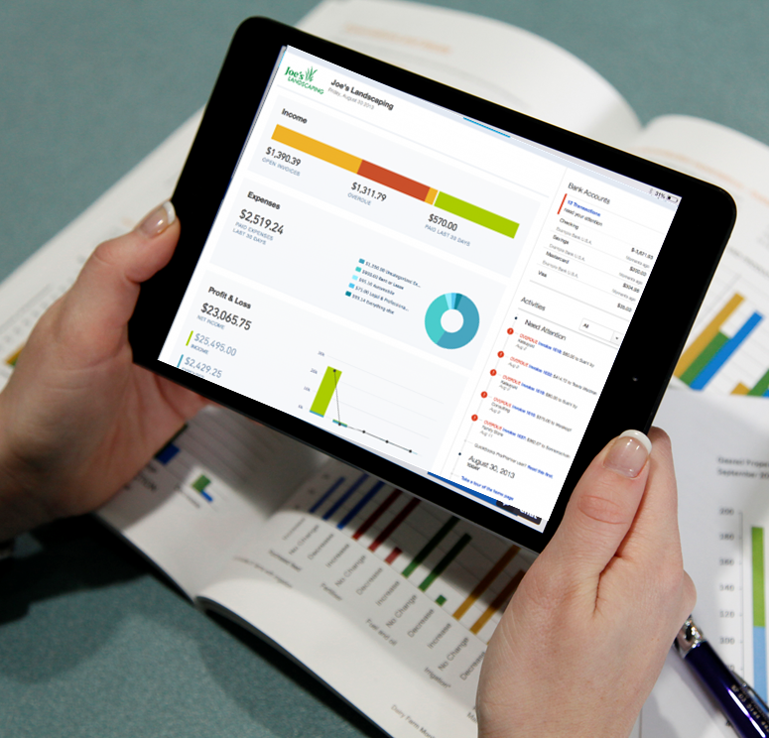
Your Turn #3…Lesson 6
  You need to make a visa payment of $378.20. Make a transfer from the Chequing account to make the payment.

Slide 83
Lesson 7
Customer and Sales Part II

Slide 84
Lesson 7 - Learning Objectives
In this Lesson you’ll learn the following:
    Advanced options on sales transactions
    Credits and Refunds
    Customer statements
    Delayed Charges & Delayed Credits
    Invoicing and Reimbursable Expenses
    Estimates

Slide 85
Advanced Sales Options
Advanced options available in QuickBooks:
Preferred Invoice Terms - determines default terms to be added to customer invoices
Preferred Delivery Method - The delivery method default determines the way you’ll deliver sales forms to newly-created customers. Customer statements
Shipping - Adds shipping fields (date, tracking number, destination, subtotal) to sales forms.
Custom Fields - Adds extra fields to sales forms. Select “Internal” to show the field in QuickBooks; select “Public” to show the field on customer forms.
Custom Transaction Numbers - Lets you use your own numbering system. If left blank, invoice numbers are automatically assigned by QuickBooks.
Notes:
Go to Account and Settings and highlight the options available and explain as needed.

Slide 86
Advanced Sales Options
    Service Date
    Discount
    Deposit
    Adds a Service date field if you need to track the date a service was performed separately from the invoice date.
    Adds a Discount field to invoices and other sales forms. In a related setting under Advanced Chart of Accounts, you can assign what account to track the discount to.
    Adds a Deposit field to invoices so you can subtract a customer deposit from the total to calculate the balance due.
Notes:
Go to Account and Settings and highlight the options available and explain as needed.

Slide 87
Your Turn #1…Lesson 7
01
02
03
    Enable the Preferred Delivery Method as Send Later.
    Enable Default Invoice Terms as Net 30.
    Disable the Discount option.

Slide 88
More - Option on Saved Forms
Copy - Duplicate the transaction. Copy the transaction if you need to create a duplicate or similar transaction for a customer.
Void - Click Void to void the invoice. Clicking Void will make the sales invoice a $0.00 transaction while maintaining the history of the invoice number and other details.
Delete - Click Delete the remove the transaction from QuickBooks. QuickBooks removes the transaction QuickBooks but it keeps a history of the transaction in the Audit log. You can see the transaction history in the Audit log.
Transaction Journal - Click the Transaction journal to discover the journal entry QuickBooks makes when you save a transaction. The transaction journal includes the debit and credit of the transaction.
Notes:
Highlight the four options on a saved transaction.
For an accounting student the most important field is the Transaction Journal. Highlight each option as needed.

Slide 89
Your Turn #2…Lesson 7
01
    Go to the last invoice created and view the More option.
02
    Choose the option to view the debits and credits.
03
04
    Copy Invoice #1004 and create the new invoice for the customer name Benjamin Yeung.
    Void the invoice.

Slide 90
Credits & Refunds Overview

Slide 91
Credit Memos & Refund Receipts
    Credit Memo
    You will use a credit memo in QuickBooks if you want to issue a credit and apply the credit against and outstanding invoice.
    Refund Receipt
    Create a Refund Receipt to refund a customer for a payment they’ve made for products or services. If you have created a Sales Receipt for the customer you typically issue a Refund Receipt.
Notes:
Define each transaction type and define when they should be used.

Slide 92
Credits & Refund Workflows Review
    Refund Receipt
    Write Cheque (optional)
    Customer has Already Paid
    Credit Memo
    Apply Credit Memo (Receive Payment)
    Open Invoices exist
Notes:
Explain that the Refund Receipt matches the Sales Receipt
The Credit memo matches the invoices transactions.
They will choose how to create the refund or the credit memo based on what transaction they previously used.

Slide 93
Your Turn #3…Lesson 7
    01
    02
    03
    Disable the Automatically Apply Credits feature.
    Create a Credit Memo for a customer named Adwin Ko for the amount of $400 + HST.
    Apply the Credit memo against Invoice #1010.

Slide 94
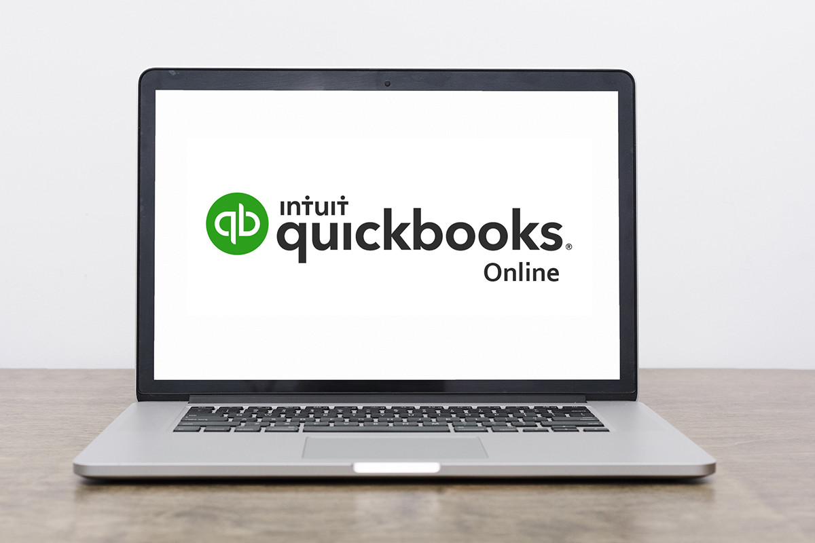
Your Turn #4…Lesson 6
  Issue a Refund Receipt for Lew Plumbing for $3738.61. Issue the refund from the Chequing account.

Slide 95
Customer Statements

Slide 96
Customer Statements Overview
    You can create a balance forward, open item, or transaction statement.
    Transaction Statement
    Balance Forward
    Open Item
    Displays all activity dated between Start and End dates. This type will show a Balance Forward amount at the top.
    Displays all open invoices from a specific date back.
    Doesn’t show a balance, just the amount of transactions and the amount received for each individual transaction.
Notes:
Define the different types of statements available in QuickBooks

Slide 97
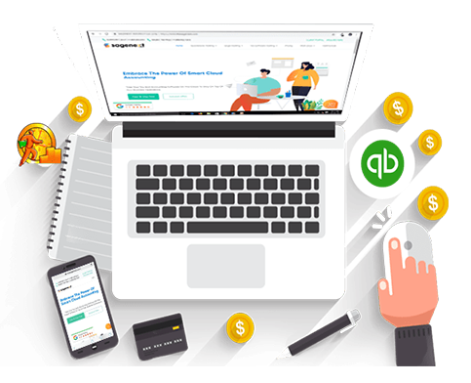
Your Turn #5…Lesson 6
  Create a Transaction Statement for all customers available in QuickBooks.

Slide 98
Delayed Charges

Slide 99
Delayed Charges Overview
    Create Delayed charges for charges that customers incur now but will be invoiced at a later time.
    Delayed charges are non-posting transactions that will not affect your accounting until they are converted to a sale
    Example: A lawn Care company delivers lawn cutting services over a month. They could enter 1 delayed charge for each week and then add the 4 weekly charges to the invoice at the end of the month.
Notes:
Overview the principles of a delayed charge.
Enter charges today and invoice for them later
Non-posting transaction

Slide 100
Delayed Charge Workflow in QuickBooks Online
Delayed charge
    Note: The Delayed Charge is a non-posting transaction
    Accounts Receivable
Invoice
Receive Payment
Make Deposit
Notes:
Review the Delayed Charge workflow.

Slide 101
Your Turn #6…Lesson 7
    01
    02
    03
    04
    Create a delayed charge for Justine Outland for Catering for $345 + HST on the first of last month.
    Create a delayed charge for Catering for $764 + HST on the 15th of last month.
    Create a delayed charge for Catering for $198 + HST on the 20th of last month.
    Create an Invoice for all charges on the last day of last month.

Slide 102
Sub-Customers

Slide 103
Sub-Customer
    Create a sub-customer when you have projects or jobs to perform for a customer in QuickBooks
    This lets you tracks the sales and expenses to a specific sub-customer instead of a customer
Notes:
Demo a sub-customer setup. Highlight points above.

Slide 104
Your Turn #7…Lesson 7
    Create a sub-customer of Ecker Designs with the following information:
    Customer Name: Christmas Party
    Billing Address: same as customer
    Select Bill with Parent
Notes:
Demo a sub-customer setup. Highlight points above.

Slide 105
Estimates in QuickBooks

Slide 106
Estimates
    Estimate is a description of work that you’ll provide for customers.
    Issue multiple estimates for a customer project
    Estimate can be converted to an invoice. This helps with accuracy and data entry
    Estimates can be used to Progress Invoice projects in %’s or amounts
    Estimate is a non-posting transaction
Notes:
Highlight the points of the estimate
Highlight the Estimate as a non-posting transaction. This is important because they do not affect the GL until an invoice is created

Slide 107
Estimate Workflow

Slide 108
Estimate Workflow
Quote (Estimate)
Send Estimate to Customer
Mark Estimate as Accepted
Copy to Invoice (Progress Invoices)
Notes:
Review the workflow of the estimate to invoice.
Highlight the status on the Estimate

Slide 109
Your Turn #8…Lesson 7
1
    Create an estimate for Ecker Designs: Christmas Party with the following information:
    Date: 15th of last month
    Service: Catering
    Description: Catering at Christmas party
    Amount: $12,000 + HST
2
    Create an Invoice for 50% of the estimate on the last day of last month.
3
    Create an Invoice for the remaining 50% of the estimate on the 15th of this month.
Notes:
Review the workflow of the estimate to invoice.
Highlight the status on the Estimate

Slide 110
Lesson 8
Suppliers and Expenses Part II

Slide 111
Lesson 8 - Learning Objectives
In this Lesson you’ll learn the following:
Credit Card charges and payments
Recurring transactions
Supplier Credits

Slide 112
Lesson 8 - Learning Objectives
You have two options to enter credit card entries:
Enter directly from the Online Banking Feed.
Enter Expense transaction type.
01
02

Slide 113
Credit Card
Entry Demo
Notes:
Demonstrate entering the expense transaction to highlight the Credit Card entry

Slide 114
Your Turn #1…Lesson 8
1
    Create a credit card charge for the following:
    Supplier - Garcia’s Event Space
    Date: 17th of last month
    Description of expense: Equipment Rental
    Amount: $3,878 + HST
2
    Create a credit card charge for the following:
    Supplier – Cass Hayden
    Date: 19th of last month
    Description of expense: Insurance
    Amount: $1,200 + HST

Slide 115
Supplier Credits
Notes:
Create a supplier credit for students

Slide 116
Your Turn #2…Lesson 8
1
    Create a supplier credit for the following:
    Supplier – Kristina Gibson (Gibson Printing)
    Date: 15th of last month
    Description of expense: Printing and Reproduction
    Amount: $200 + HST
2
    Apply the Supplier credit against the outstanding bill for Kristina Gibson.

Slide 117
Recurring Transactions
Notes:
Review of Recurring transactions

Slide 118
Recurring Entries
Recurring entries in QuickBooks can help you perform a variety of functions:
01
02
03
    Automatic recurring transactions can be Scheduled in QuickBooks: Examples include automatic debits from your bank for lease payments, rent payments, bank charges, etc.
    Setup a Reminder for specific transactions in QuickBooks: Examples include loan payments, monthly journal entries, etc.
    Save transactions for future use as Unscheduled transactions: Examples include tricky entries like journal entries, daily sales summaries

Slide 119
Recurring Transactions Demo
Notes:
Review of Recurring transactions

Slide 120
Your Turn #3…Lesson 8
1
    Create a recurring bank charge expense:
    Account – Chequing Account
    Date: 15th of every month
    Description of expense: Monthly activity fee
    Amount: $15 with no tax
2
    Create a recurring invoice for the following:
    Customer – Alba Fay
    Date: Last day of every month
    Product / Service & Description of sale: Catering: Catered weekly lunch
    Amount: $1000 + HST

Slide 121
Lesson 9
Payroll & Employees

Slide 122
Lesson 9 - Learning Objectives
In this Lesson you’ll learn the following:
Create Records of Employment
Setting up employees
Creating Paycheques
Track and pay liabilities
Create T4’s

Slide 123
Lesson 10
Inventory

Slide 124
Lesson 10 – Learning Objectives
In this Lesson you’ll learn the following:
Order and receive inventory using Purchase orders
Enable and setup inventory
Create Inventory Reports
Adjust inventory
Sell inventory

Slide 125
Reasons to track Inventory
    When you use purchase orders to buy inventory items, QuickBooks updates your inventory, so you know which items are on order and when they’re due to be received
    You can easily keep track of the cost to you of the items you have sold (the cost of goods sold)
    You can easily keep track of the income you receive from the sale of inventory items
    You always know your current quantities on hand
    You always know the current value of your inventory

Slide 126
How QuickBooks Handles Inventory
    QuickBooks Online uses First in First Out (FIFO) as its costing method.
    QuickBooks Online will always consider the first units purchased (First In) to be the first units sold (First Out) and will adjust your assets and Cost of Goods Sold (COGS) accordingly whenever sales of inventory items are entered.
Notes:
Explain the basic rules of QuickBooks and how it handles inventory

Slide 127
Your Turn #1…Lesson 10
01
Your company starts selling inventory. Enable the feature in QuickBooks
Notes:
Go to Account and Settings and enable the feature under sales setting. Track quantity on hand

Slide 128
Setting up Inventory Parts
QuickBooks requires several important pieces of information when setting up inventory:
Reorder Point (QB reminds you when you pass a certain point in stock to order more)
Product name is required… Category and SKU (optional)
Initial quantity on hand (enter 0 to start) and As of date
Inventory Asset account
(QB chooses if you don’t)
Notes:
Explain each field of the setup.

Slide 129
Setting up Inventory Parts Cont.…
Enter the Description and Sales Price (optional fields…if the price changes leave these fields blank)
Choose the Income Account. This will be an income account to track sales
Choose the sales Tax if required.
Enter the Purchase Information and Cost (your cost to purchase the item)
Enter the Expense account (required…QB chooses Cost of Goods Sold if you don’t edit it)
Enter the Purchase tax
Notes:
Review each field and explain the purpose of the required fields. Explain others as optional and that they can be entered as you go on transactions.

Slide 130
Your Turn #2…Lesson 10
Your company opened a gift shop and you started stocking the following items. Set them up in QuickBooks:
Water Bottle - SKU #482379
Sales Price
– $18 tracked to Sales account. Add HST.
Description
– 16oz. Stainless Steel water bottle
Cost to purchase – $7.34 tracked to Cost of Goods Sold. Add HST.
When in stock track them to Inventory Asset.
Notes:
Explain each field of the setup.

Slide 131
Your Turn #3…Lesson 10
Add this item…
Umbrella - SKU #89887
Sales Price
– $19.95 tracked to Sales account. Add HST.
Cost to purchase – $3.88 tracked to Cost of Goods Sold. Add HST.
Description
– Black umbrella medium
When in stock track them to Inventory Asset.
Notes:
Explain each field of the setup.

Slide 132
Your Turn #4…Lesson 10
Add this item…
Headphones - SKU #99202
Sales Price
– $13.95 tracked to Sales account. Add HST.
Cost to purchase – $2.78 tracked to Cost of Goods Sold. Add HST.
Description
– White deluxe headphones
When in stock track them to Inventory Asset.
Notes:
Explain each field of the setup.

Slide 133
Your Turn #5…Lesson 10
Add this item…
Cell Phone Charger - SKU #99102
Sales Price
– $14.95 tracked to Sales account. Add HST.
Cost to purchase – $5.09 tracked to Cost of Goods Sold. Add HST.
Description
– Multi port charger
When in stock track them to Inventory Asset.
Notes:
Explain each field of the setup.

Slide 134
Purchase Orders
PO’s are non-posting transactions
Receive against
Key features of Purchase Orders:
Feature in QuickBooks Online Plus
PO’s on any purchase transaction
Used to order inventory parts and manage receipt of products and backorders
Notes:
Explain each field of the setup.

Slide 135



Your Turn #6…Lesson 10
Order the following items on a purchase order to a new Vendor called:
Gift Shop Wholesale
Cell Phone Charger
Quantity 20
Umbrella
Quantity 5
Water Bottle
Quantity 25
Notes:
Explain each field of the setup.

Slide 136
Your Turn #7…Lesson 10
Receive the following items on a bill (#2892) from
Gift Shop Wholesale
Cell Phone Charger
Quantity 18
Umbrella
Quantity 5
Water Bottle
Quantity 22
Notes:
Explain each field of the setup.

Slide 137
Your Turn #7…Lesson 10
Receive the remaining items on a bill (#2899) from
Gift Shop Wholesale
Cell Phone Charger
Umbrella
Water Bottle
Notes:
Explain each field of the setup.

Slide 138
Your Turn #9…Lesson 10
You need to report on your inventory for your boss. Create the following reports:
Inventory Valuation Summary
Inventory Valuation Detail
Notes:
Explain each field of the setup.

Slide 139
Your Turn #10…Lesson 10
You need to adjust your inventory for damaged and missing goods. You lost the following items to damage
Cell Phone Charger
2 were damaged
Umbrella
1 was stolen
Water Bottle
3 were stolen
Notes:
Explain each field of the setup.

Slide 140
Lesson 11
QuickBooks Reports

Slide 141
Lesson 11 – Learning Objectives
In this Lesson you’ll learn the following:
Create basic reports in QuickBooks Online
Customize reports using Filters and
Columns / Rows
Saving Customized reports
Automating reports
Notes:
Explain each field of the setup.

Slide 142
Report Types
There are several report types that you can work with in QuickBooks:
Transaction reports
List reports
Summary reports
Detail reports
Notes:
Discuss the report types in QuickBooks

Slide 143
Transaction Reports
There are several transaction reports that every company needs:
    Profit & Loss Report - reports on the financial performance of your business
    Balance Sheet - reports on the financial position of your business
    A/R Aging Summary - reports on your outstanding customer accounts
    A/P Aging Summary - reports on your outstanding supplier accounts
    General Ledger - reports on your transactions by account
Notes:
Discuss the report types in QuickBooks demo reports as you go

Slide 144
Summary vs. Detail Reports
List reports include the following:
Account
Listing
Customer
Contact List
Supplier
Contact List
run report from the Chart of Accounts
list of customers
list of suppliers
Notes:
Discuss the report types in QuickBooks demo reports as you go

Slide 145
Summary vs. Detail Reports
Summary Reports
Detail Reports
Summary of transactions in balances i.e. A/R Aging Summary
Limited customization
Details of individual transactions in
Full customization
Notes:
Discuss the report types in QuickBooks demo reports as you go

Slide 146
Your Turn #1…Lesson 11
Create the following reports
Profit & Loss for this year to date
General Ledger
A/R Aging Summary
A/P Aging Summary
Balance Sheet

Slide 147
Customizing Reports
Columns
Filters
Edit the columns to display on
a report
Limited customization of width
Filter information out of a report
Use multiple filters on a report
Notes:
Discuss the filters and columns options available on most reports.

Slide 148
Your Turn #2…Lesson 11
Create the customized report from the Transaction List by Date
1
Columns to display
2
Filters
    Date
    Transaction Type
    Name
    Amount
    Transaction type - Invoice
    A/R Paid – Unpaid
    Dates – This year
Notes:
Discuss the filters and columns options available on most reports.

Slide 149
Your Turn #3…Lesson 11
01
02
03
    Save the customized report to the My Custom Reports list
    Setup a new report group called Weekly Reports and save the report to the group. Give it the name of your choice.
    Setup the report group to email the reports once a week at a time of your choice.

Slide 150
Lesson 12
Company Activities Part II

Slide 151
Lesson 12 – Learning Objectives
In this Lesson you’ll learn the following:
Customize form templates
Make Journal Entries
Filing Sales tax

Slide 152
Filing Sales Tax Demo
Notes:
Go to Taxes and then click Sales tax tab.
Click prepare return.
Click any link to demonstrate the details below on reports
Click Mark as filed

Slide 153
Your Turn #1…Lesson 12
01
02
File Sales Tax for the most recent quarter available.
Make Payment for filed return immediately after filing.

Slide 154
Customize Form Template Demo
Notes:
Demo all fields and options on the customize forms options under the Gear icon.

Slide 155
Your Turn #2…Lesson 12
    Create a new Sales Invoice with the following features:
    Name: Sales Invoice #1
    Title: Sales Invoice
    Font: Helvetica 12
    Logo: Add any logo from your computer
    Columns: Including only the Description, Amount and Tax. Ensure to name the columns appropriately. Remove all the unnecessary columns
    Fields: Remove Customer Business Account number.

Slide 156
Conclusion
  Insert details as needed for the conclusion of the class…

